Slide 1
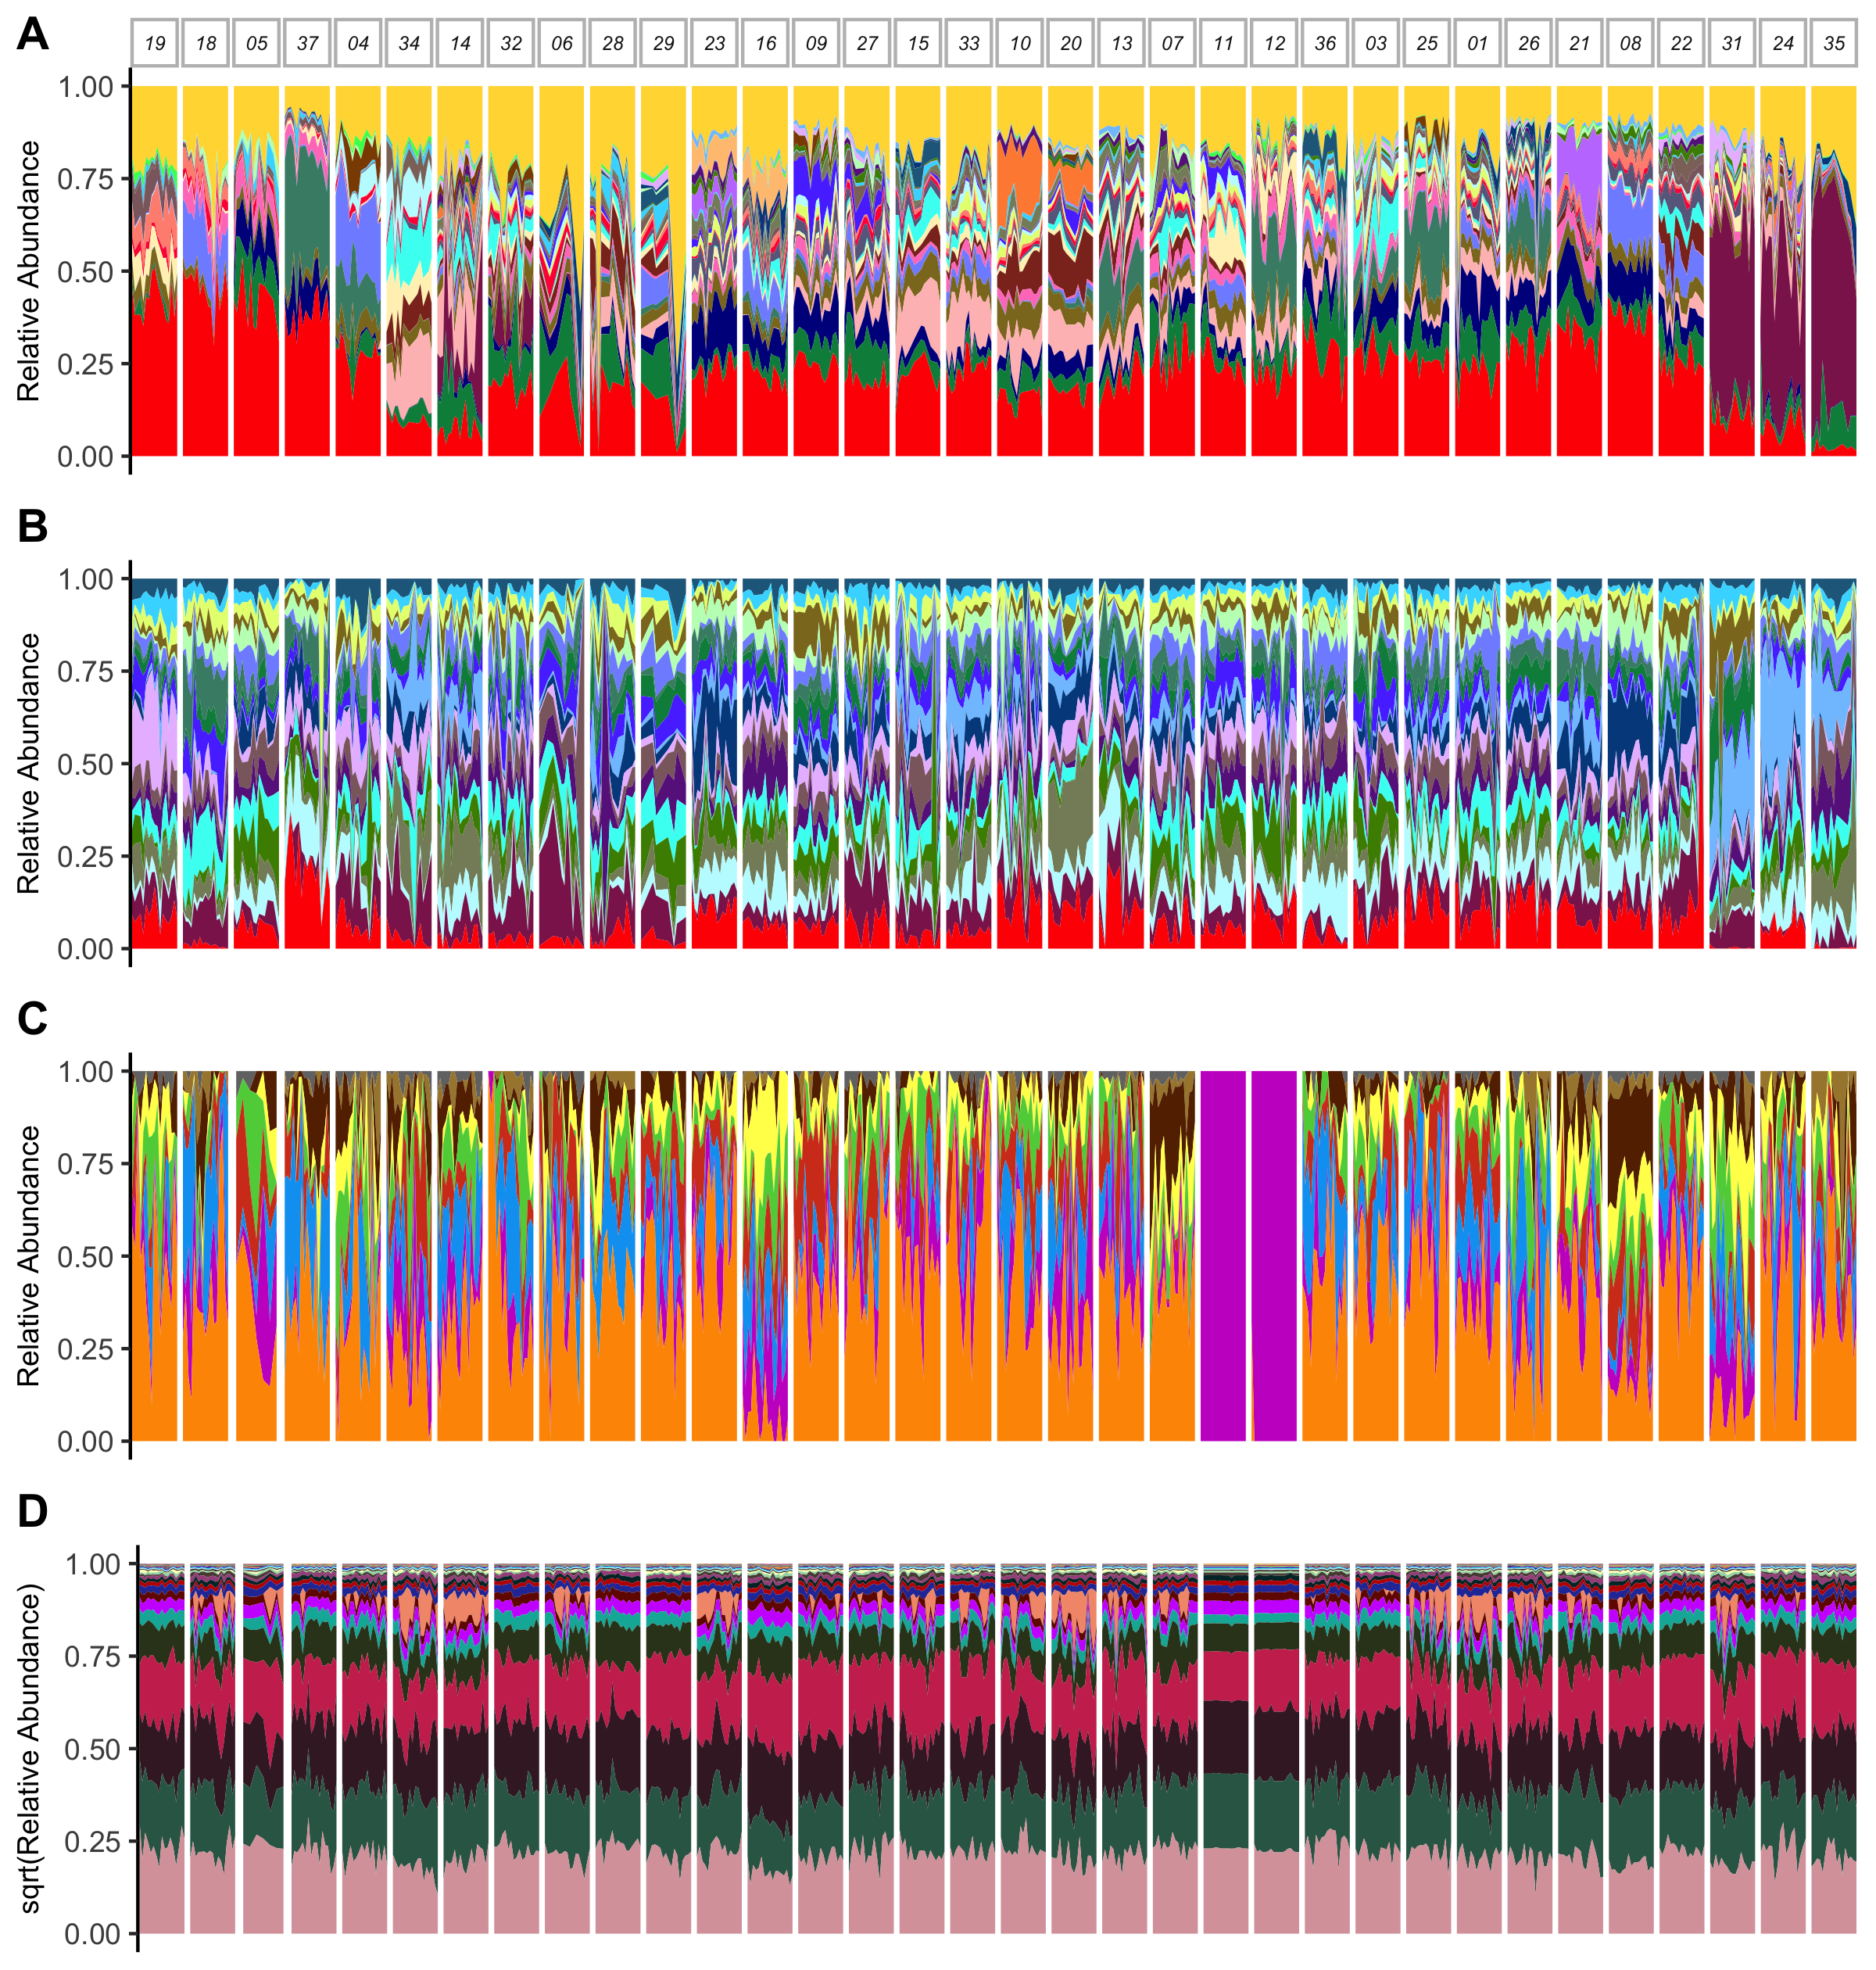
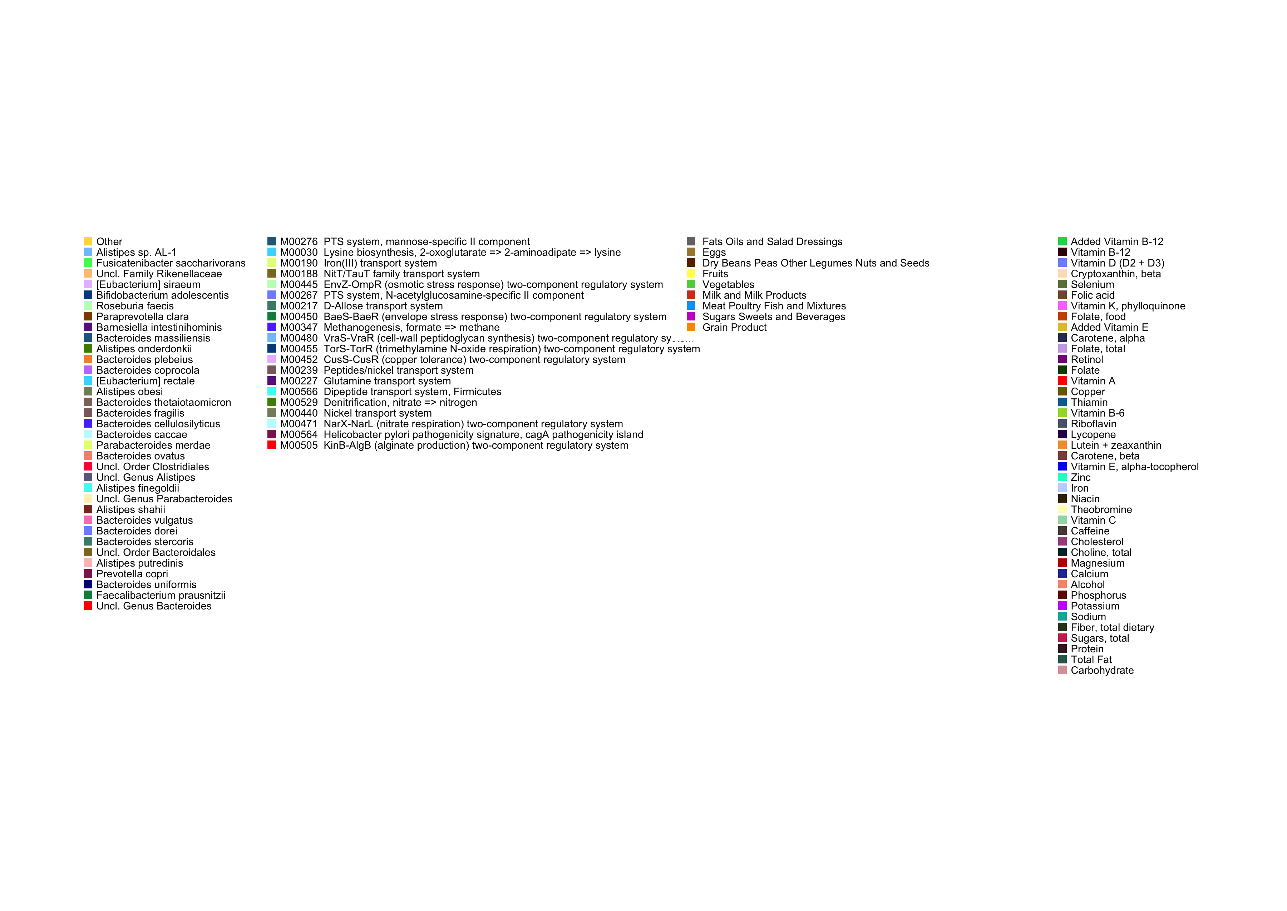
*
*
*
*
Notes:
Figure 1: Daily microbiome variation and dietary intake are highly individualized

Slide 2
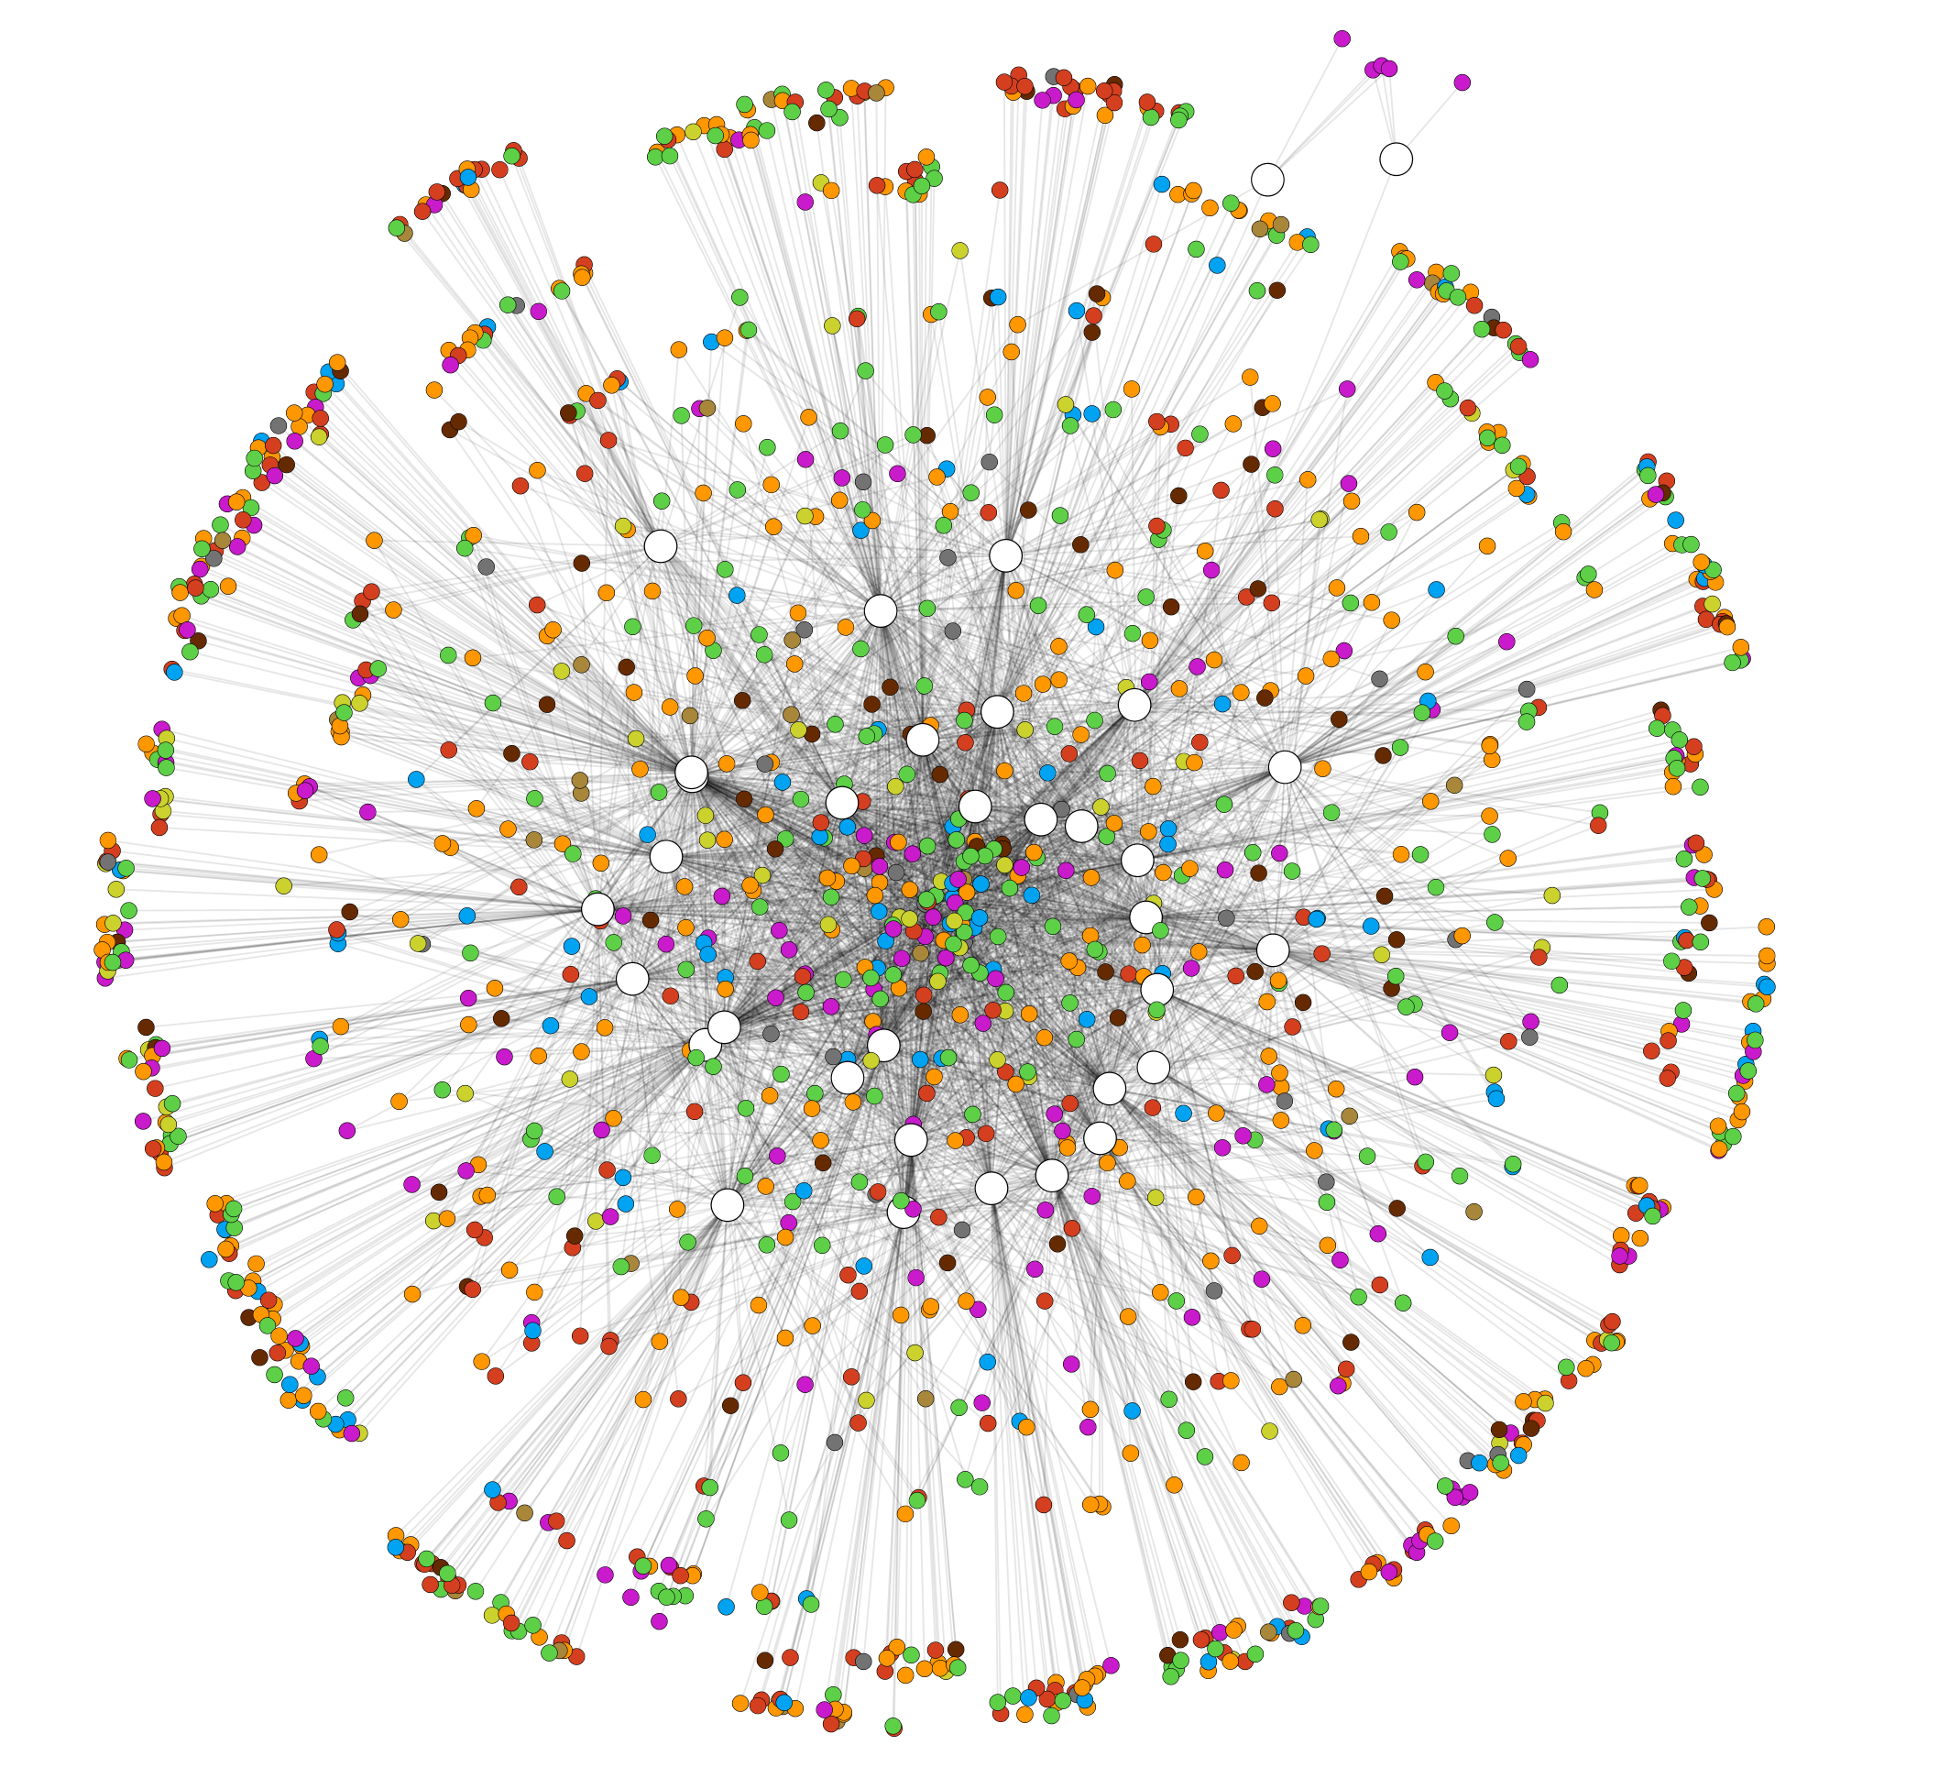
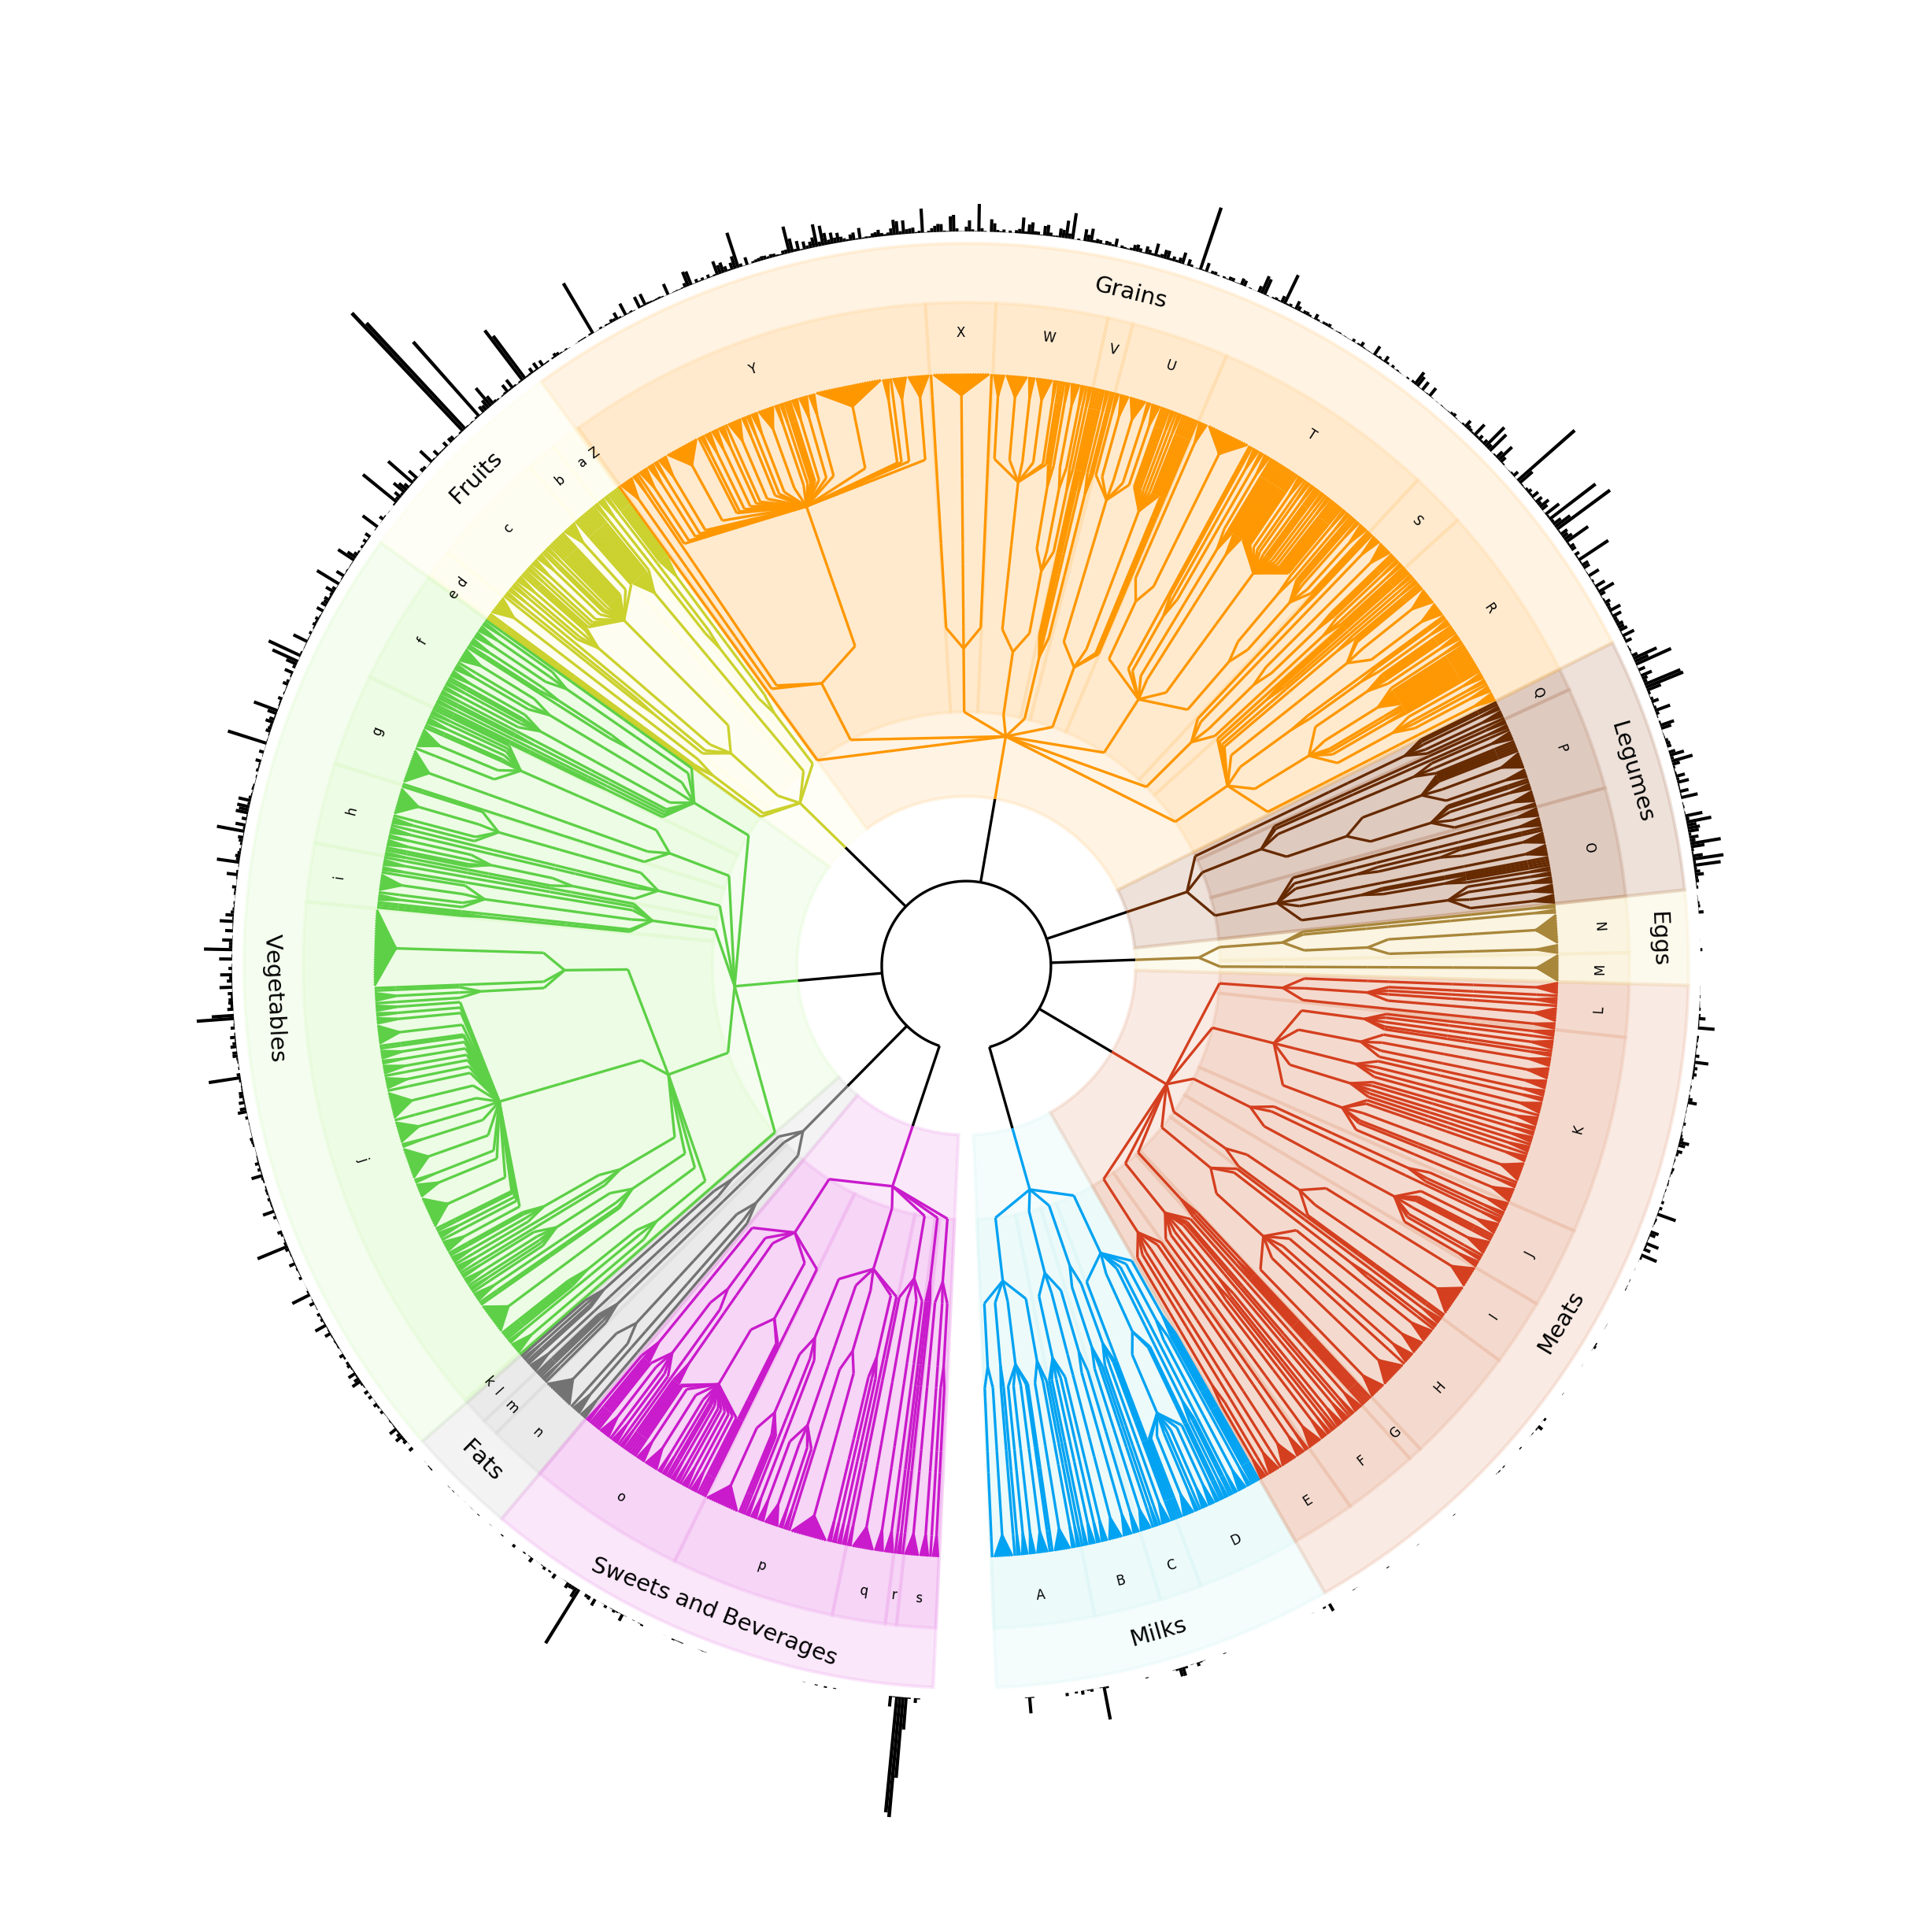
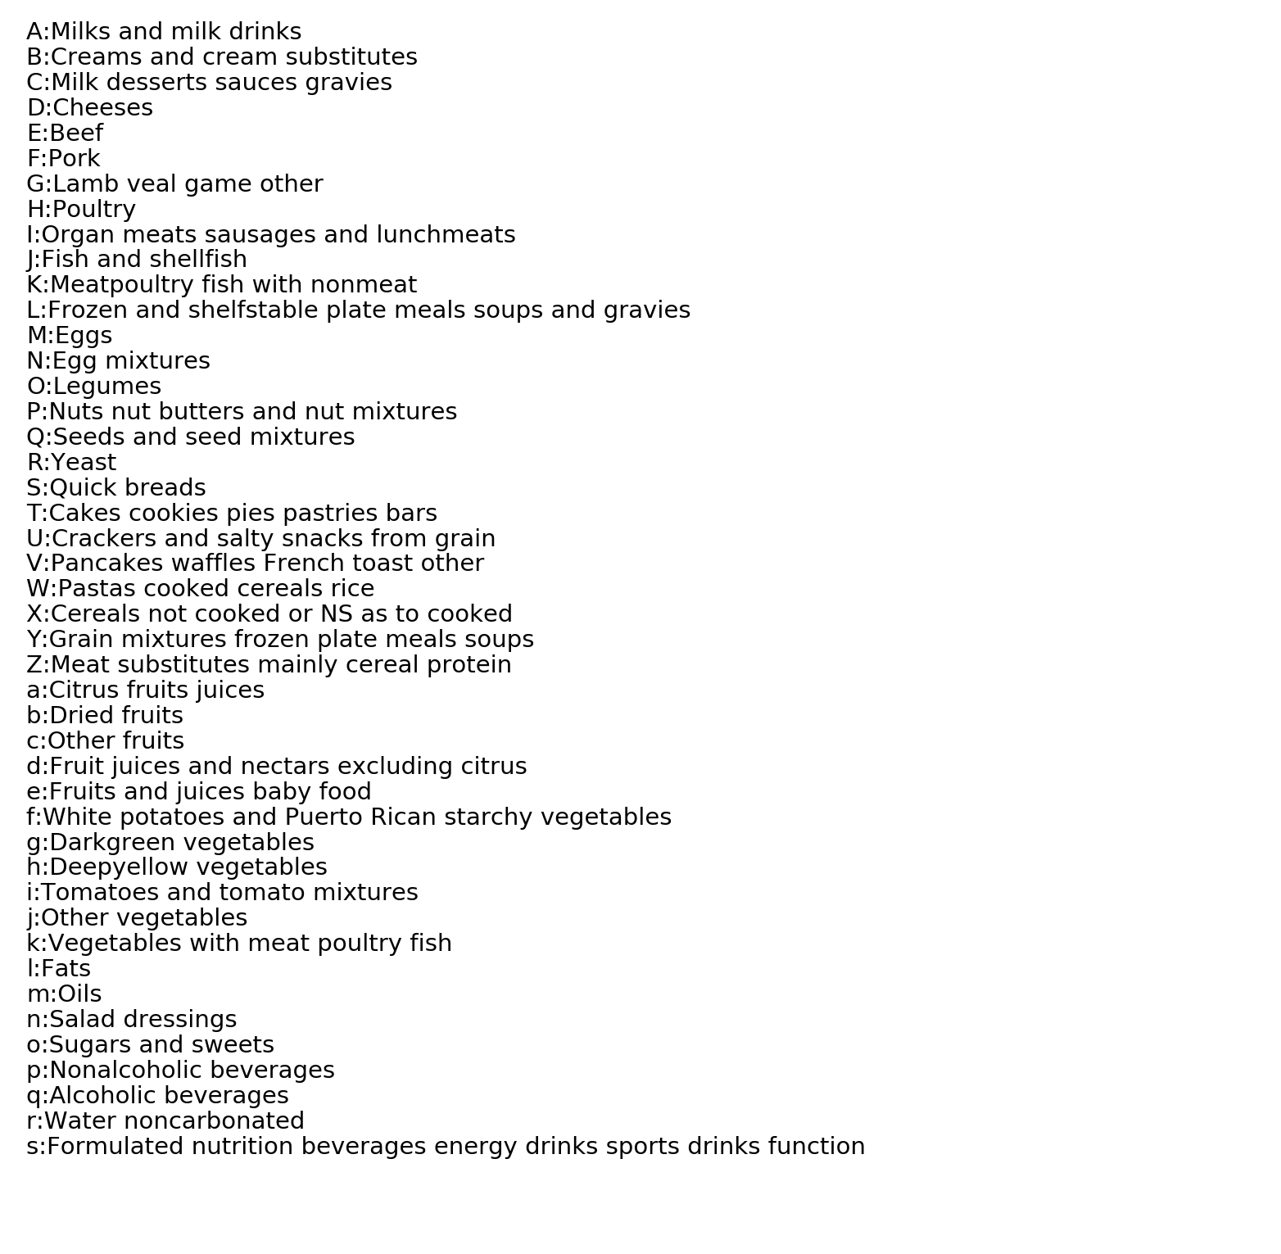
A
Soylent subjects
Shared foods
Unique foods
B
Average fiber (g)
Notes:
A) Network diagram of food choices. Cytoscape edge-weighted spring embedded layout. White circles represent individuals in the research study. Colored circles represent individual food items. Individual food items are colored by food group corresponding to the FoodTree. Foods closest to the center of the image are consumed by the most people and foods on the periphery of the network are unique to 1 or 2 individuals. Of note, the two Soylent consuming subjects are located in the lower right quadrant of the figure and are only connected to the larger network due to consumption of either coffee (subject 11) or pizza (subject 12). B) FoodTree is a hierarchical, phenetic tree of food groups that is built from the Food and Nutrition Database for Dietary Studies. Output from FoodTree includes total food intake or specific nutrient intake in grams by person and a corresponding tree for analysis of tree-based diversity metrics. Relationships between foods and the 9 food groups are shown on the interior of the image, secondary food grouping levels (see legend) are included around the tree. Black bars extending from the periphery of each leaf correspond to the average amount of fiber reported from all participants for that food throughout the study.
Average grams of fiber. Legend along the bottom.

Slide 3
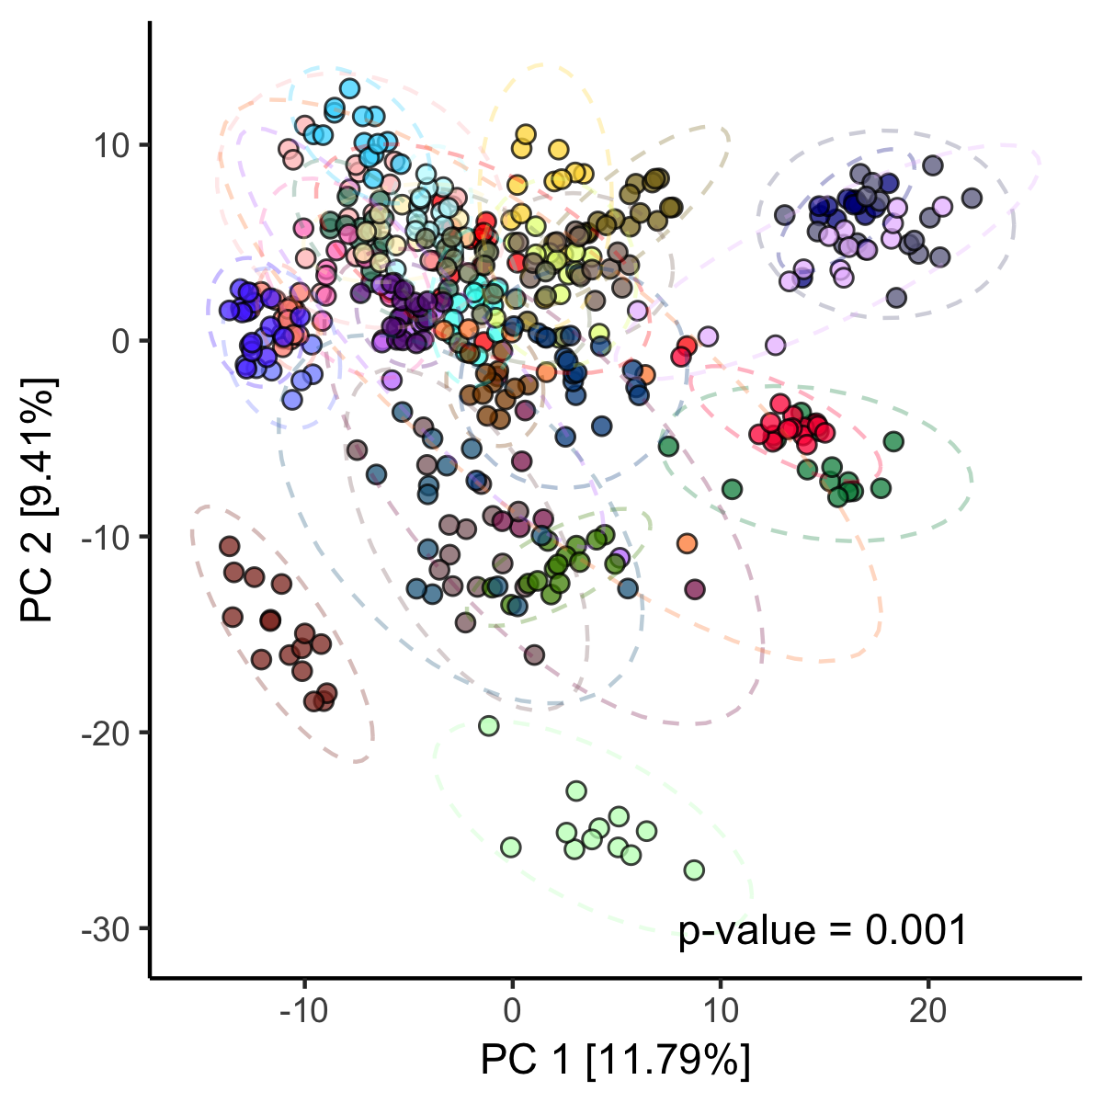
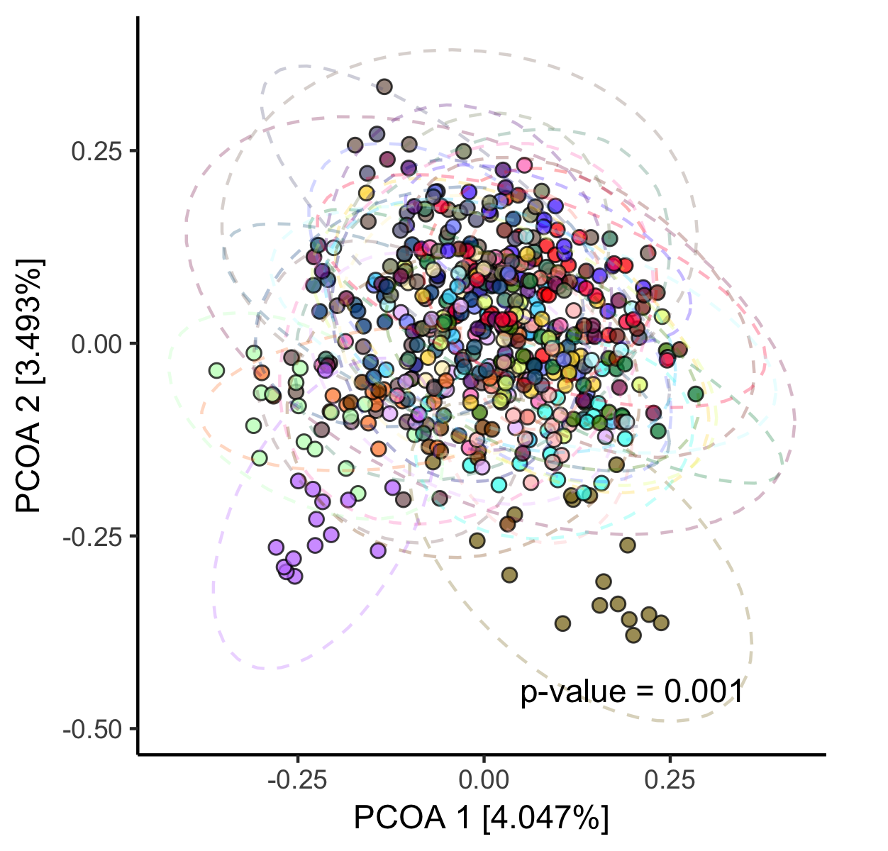
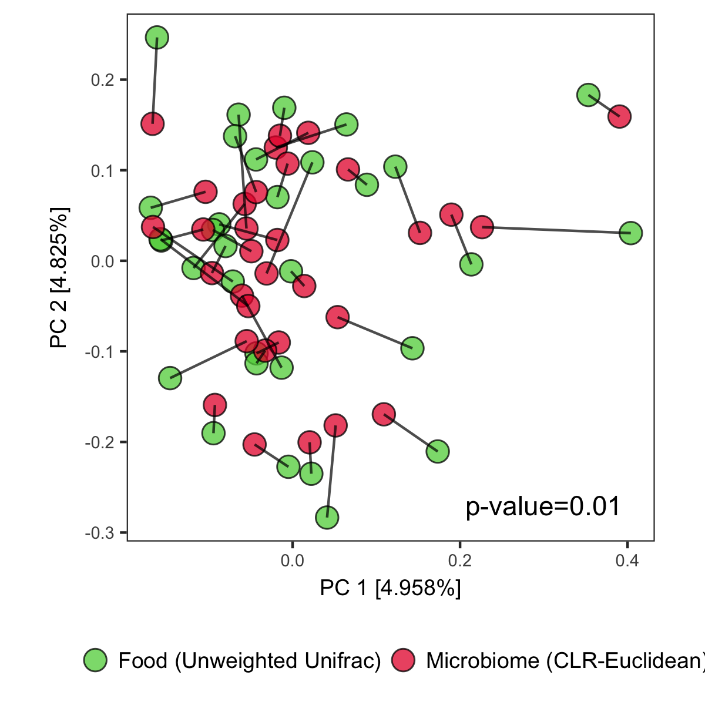
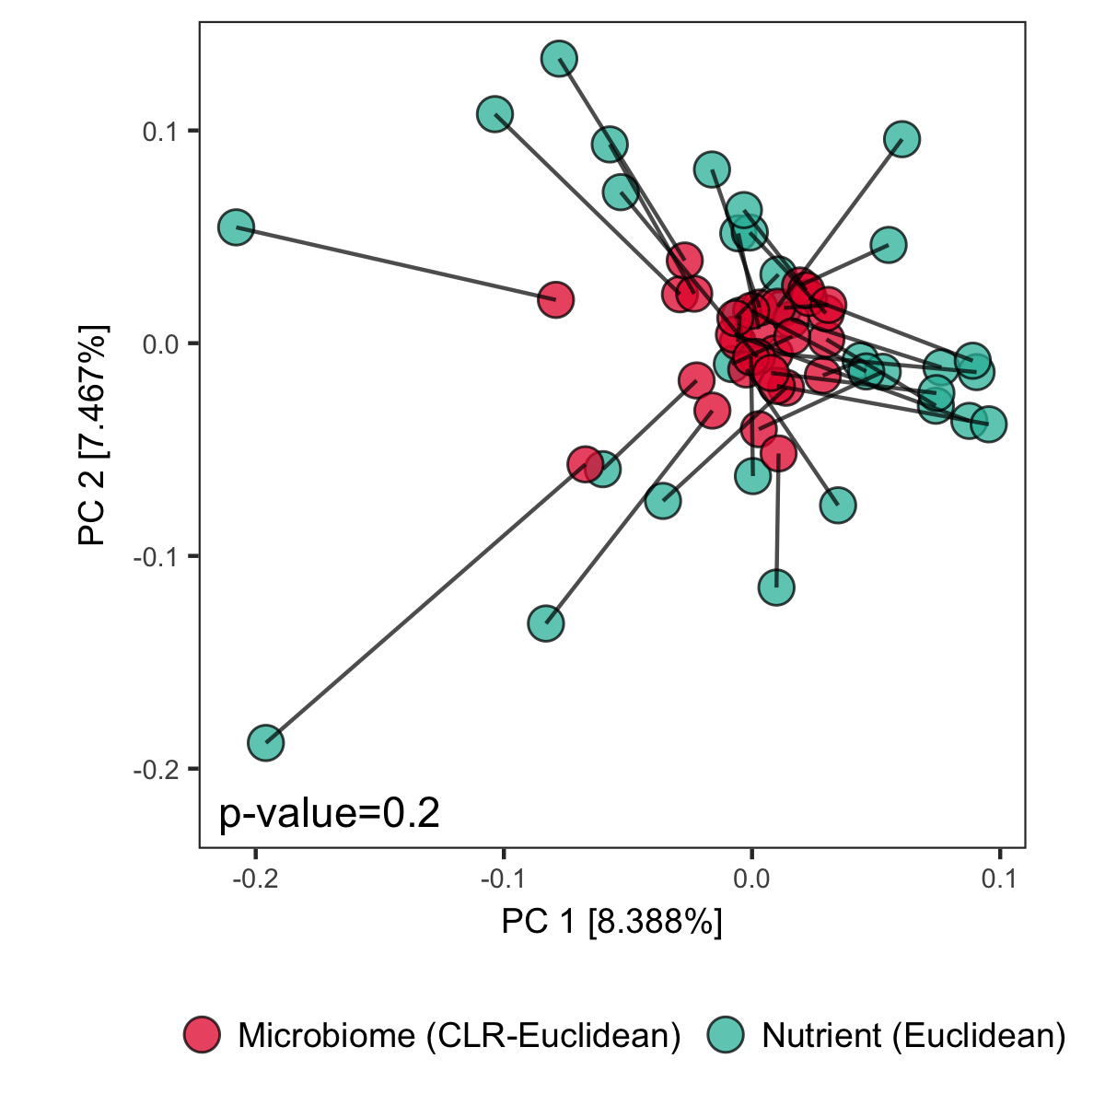
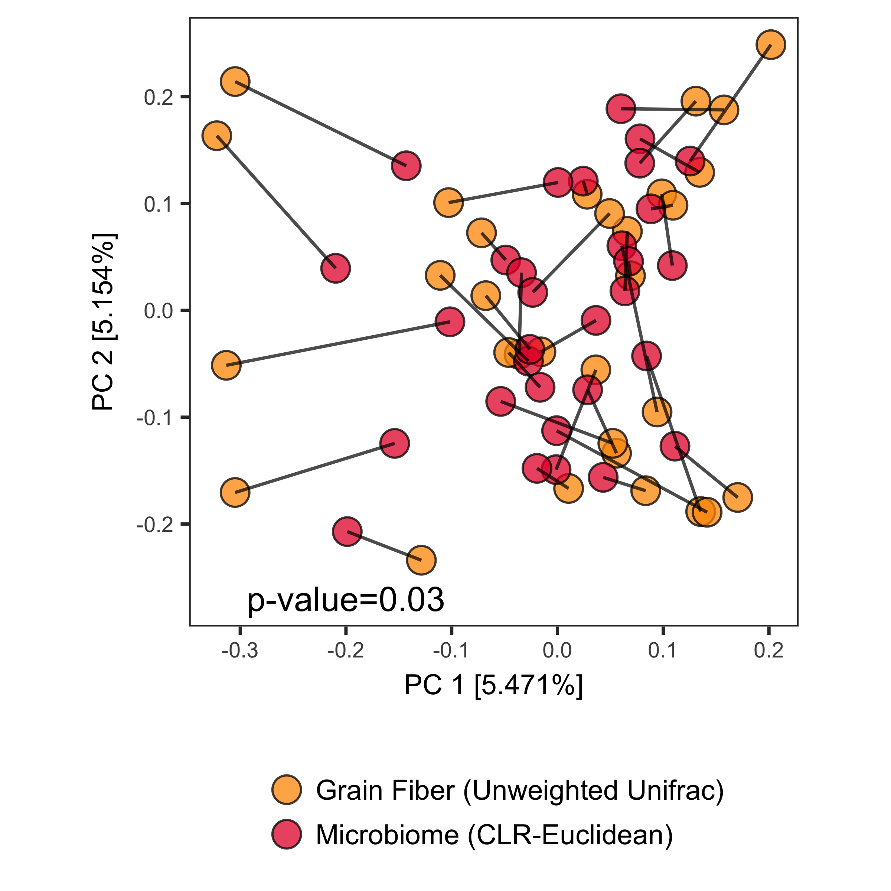
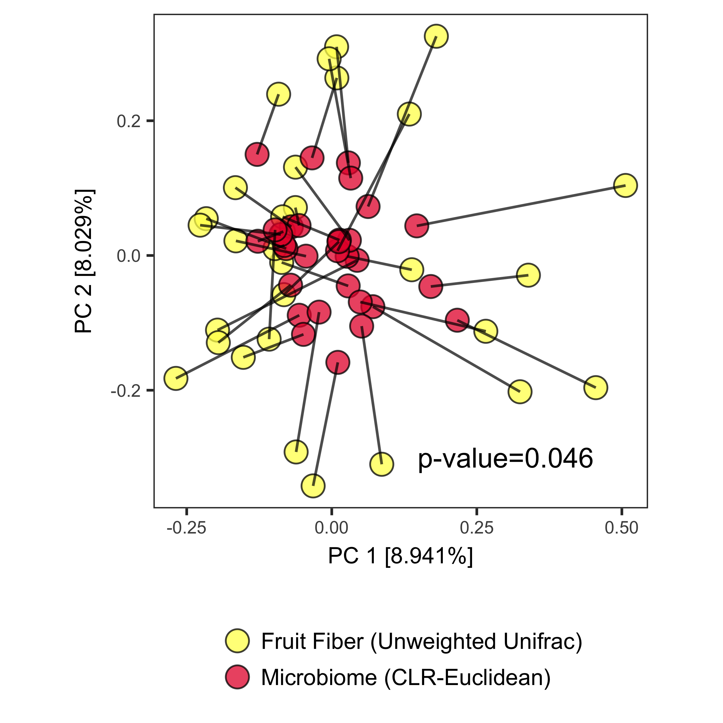
A
B
C
D
E
F
Fiber from grains
Fiber from Fruits
Notes:
Add the three principal component analysis plots to this figure on the top line. Mention those first before introducing the procrutes.
A) Significant agreement between average diet and average microbiome when diet is considered as food choices and processed with unweighted unifrac using Food Tree. B) No significant agreement using normalized nutritional intake variables. C) Trend towards agreement between average diet and function. D) No significant agreement between nutrients and function. E) Fiber diversity from grains pairs with microbiome. F) Fiber diversity from fruits and microbiome.
One legend at the bottom.

Slide 4
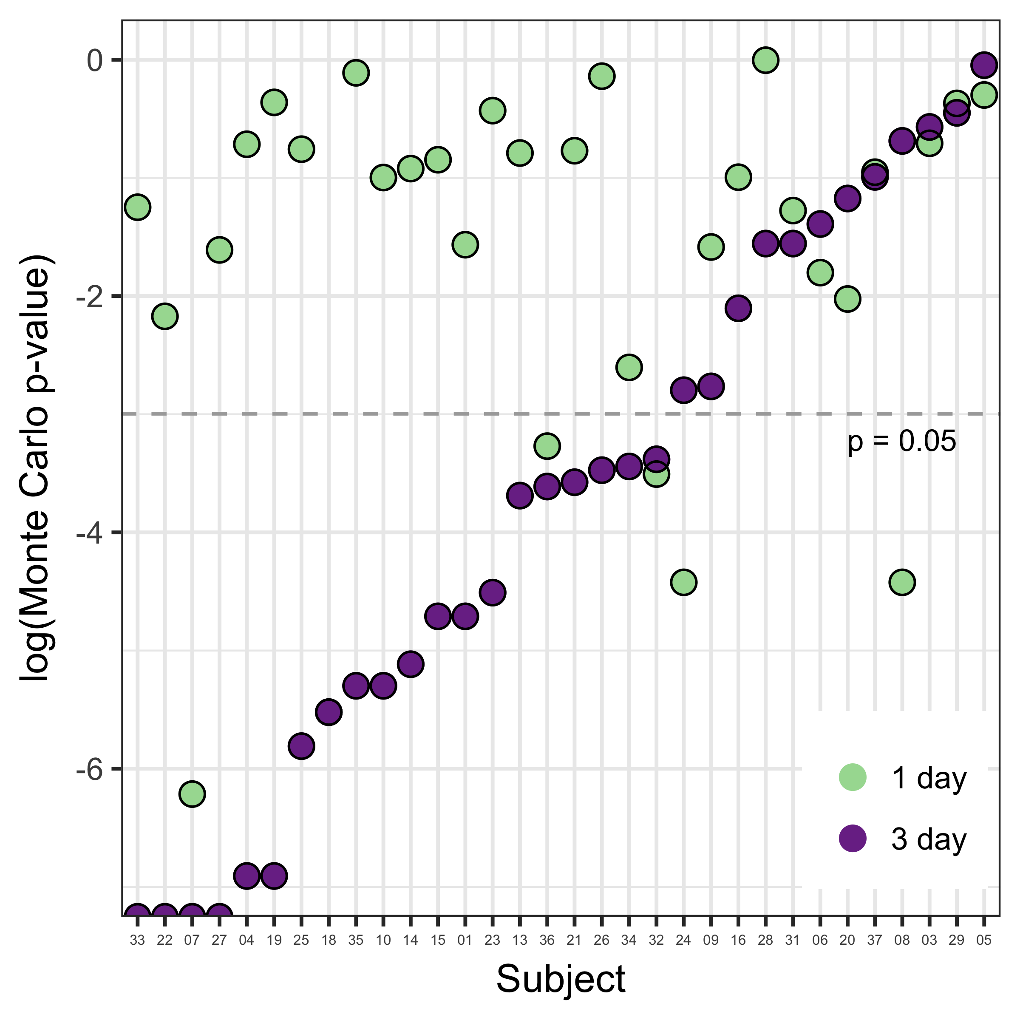
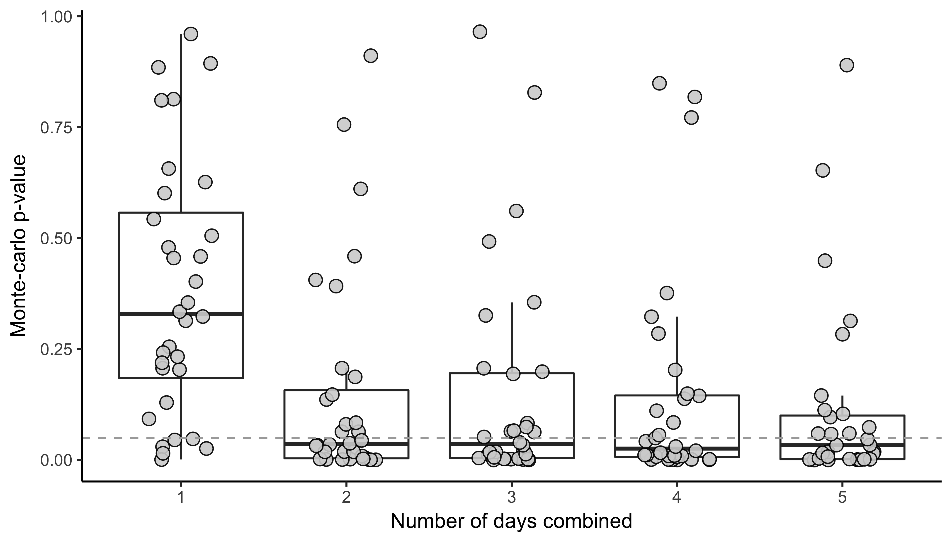
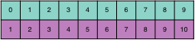
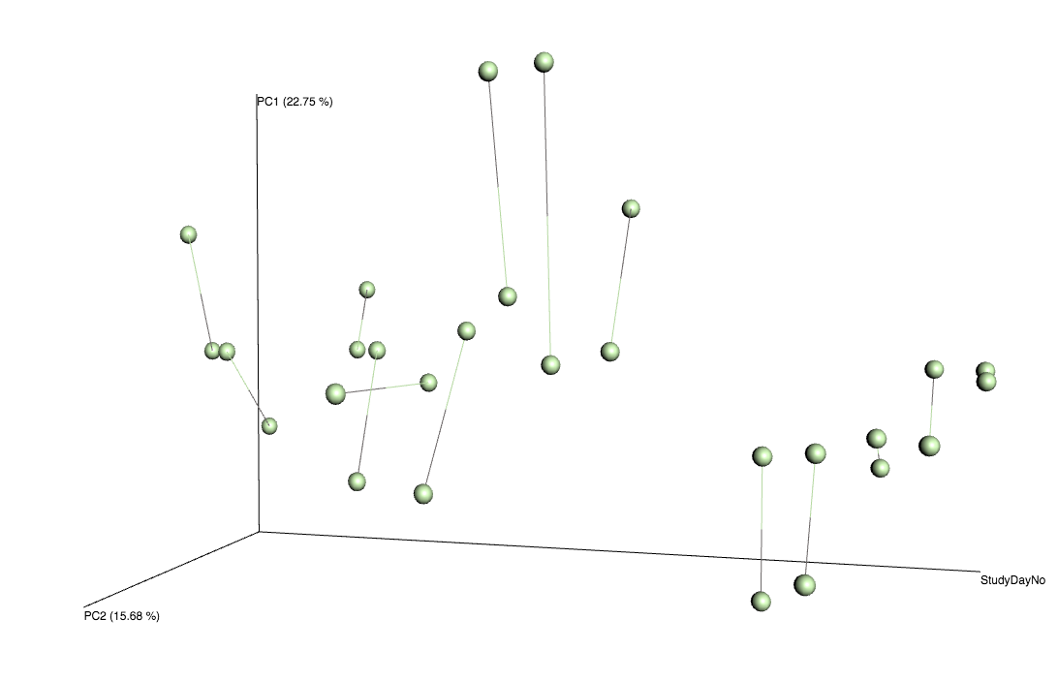
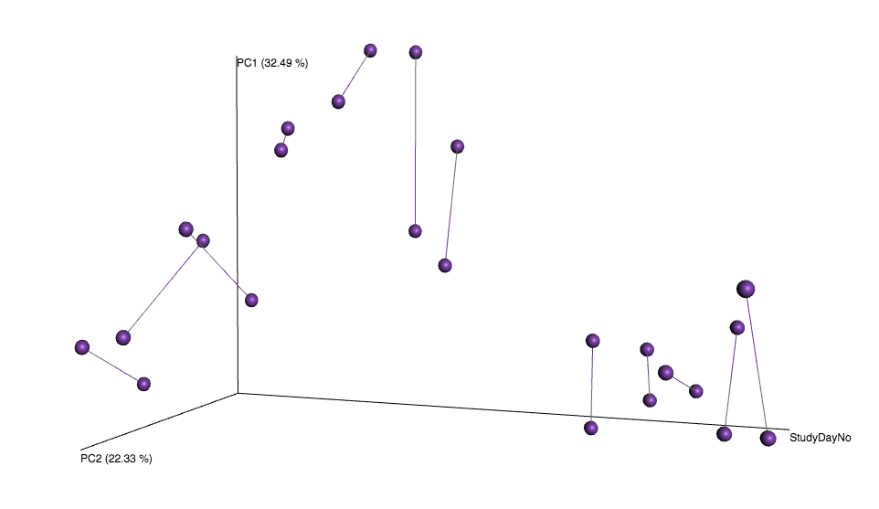
A
B
C
D
p-value = 0.02
p-value = 0.5

Slide 5
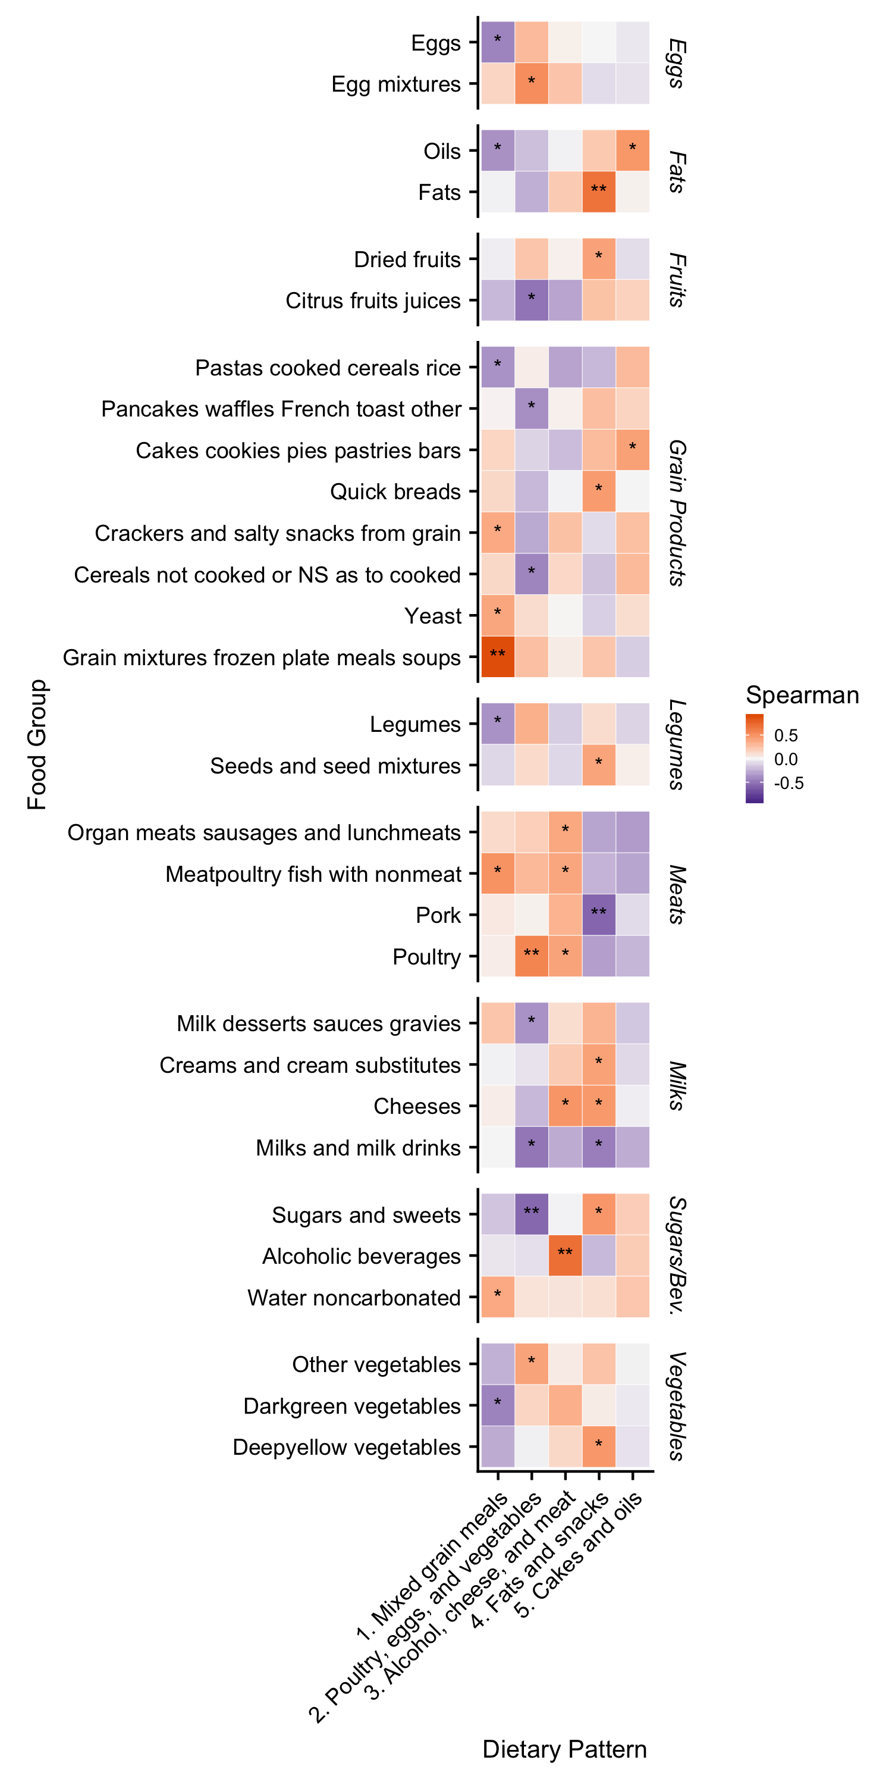
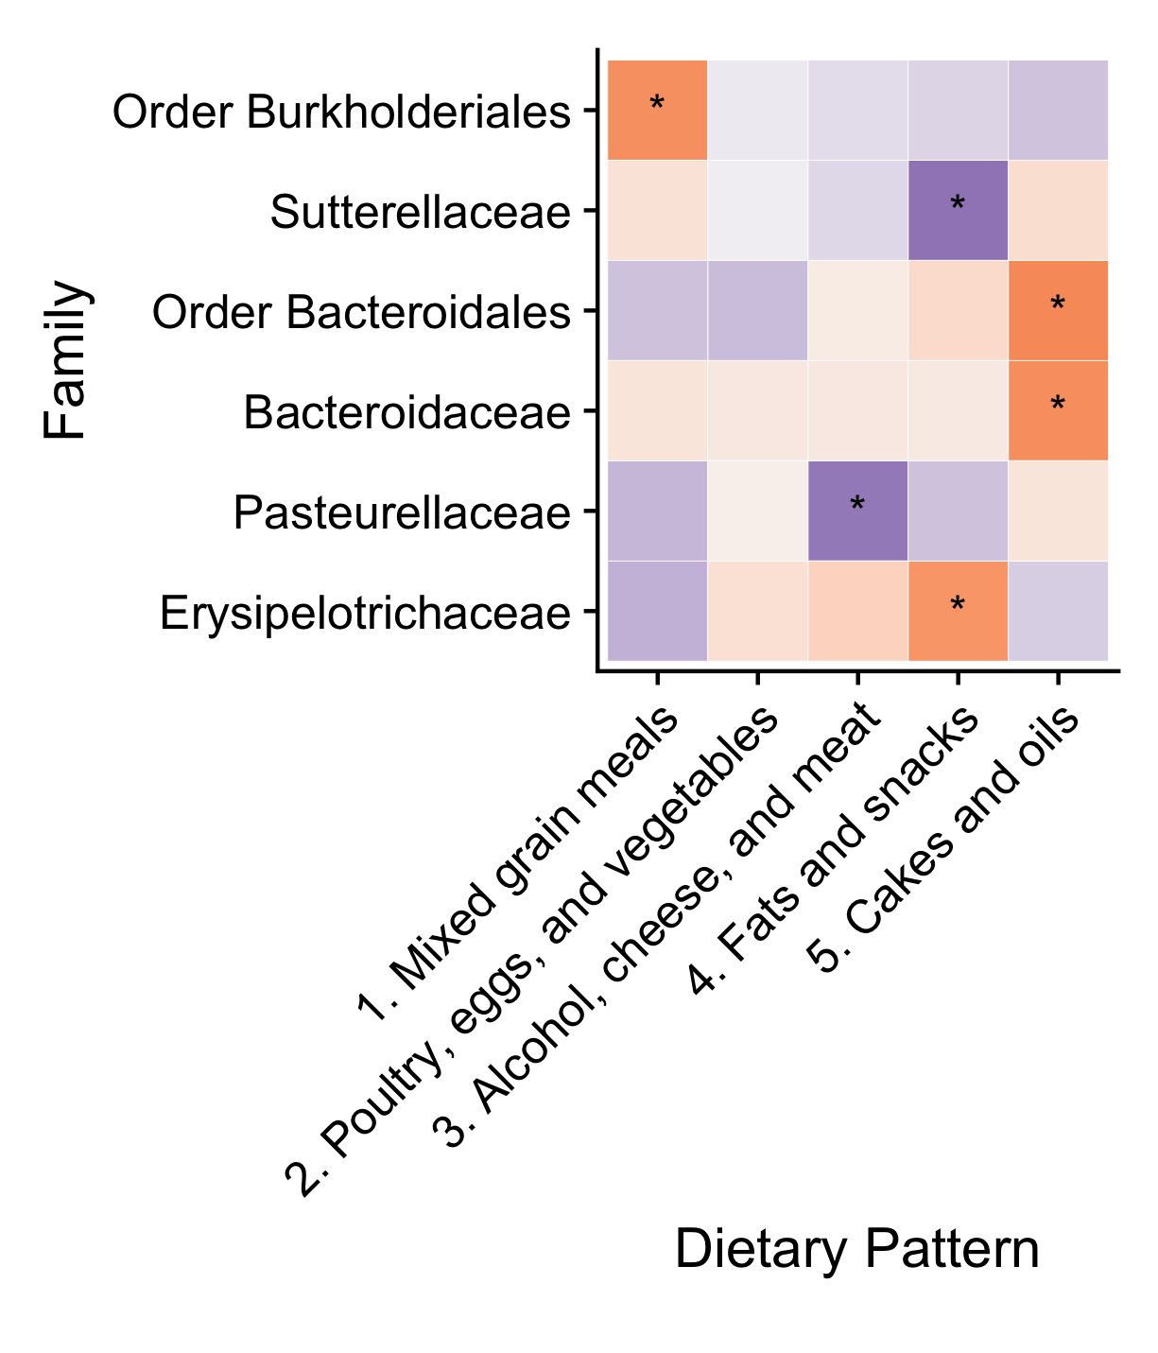
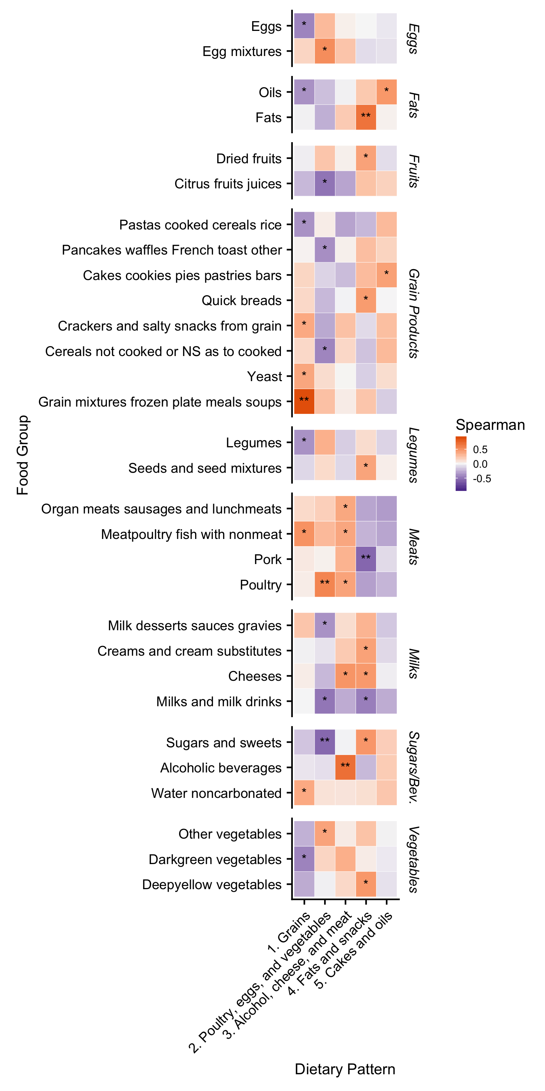
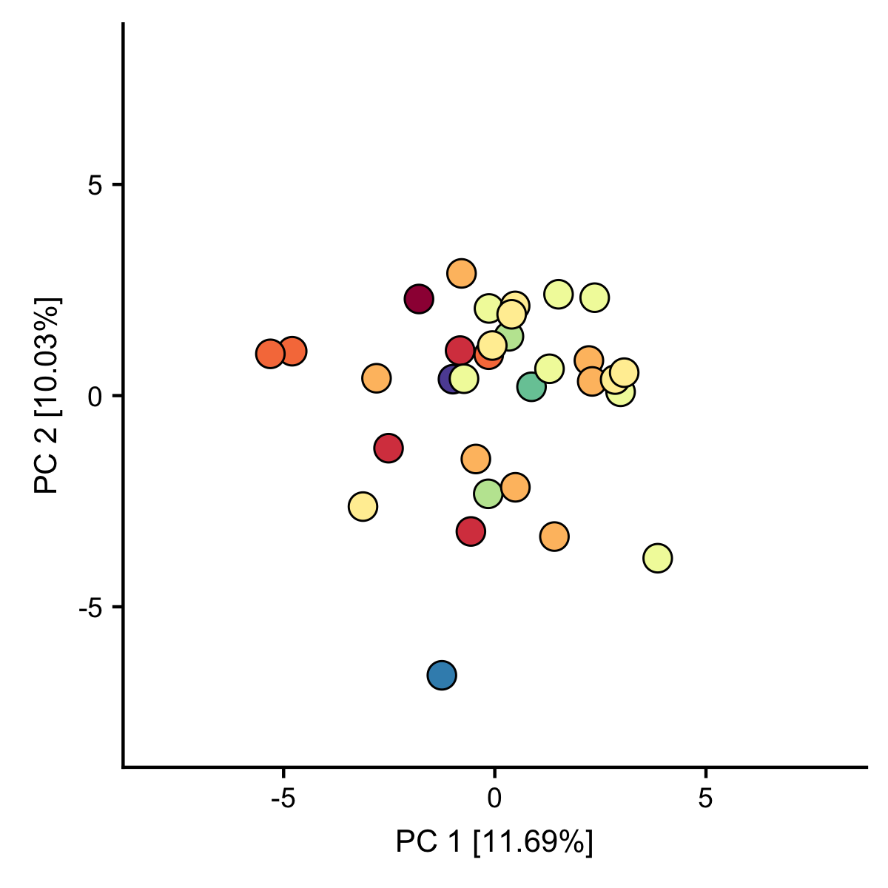
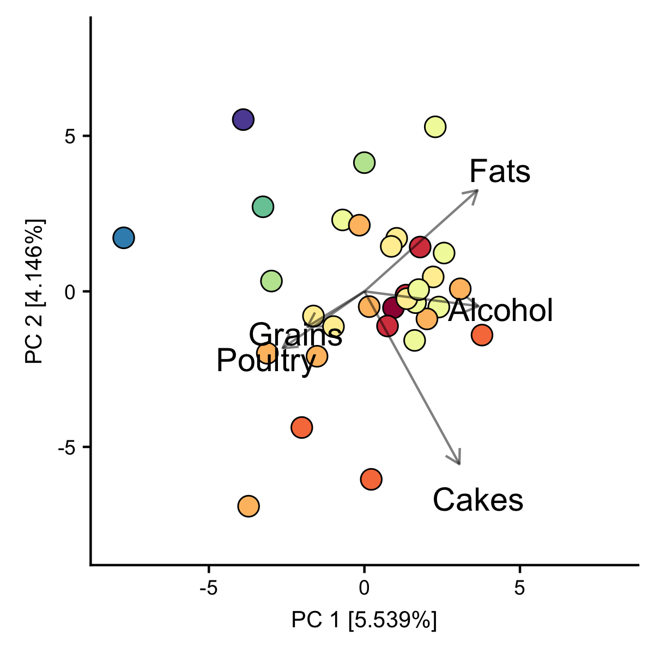

A
B
C
D
Notes:
Correlation between diet vectors (weighted Unifrac) and foods.
Correlation between diet vectors (weighted Unifrac) and family-level taxonomy.
Unconstrained colored by phylum Bacteroides ratio.
Constrained by dietary patterns colored by phylum Bacteroides ratio.
Dietary patterns within people.
Patterns v. nutrients. Could that help people understand this analysis.

Slide 6
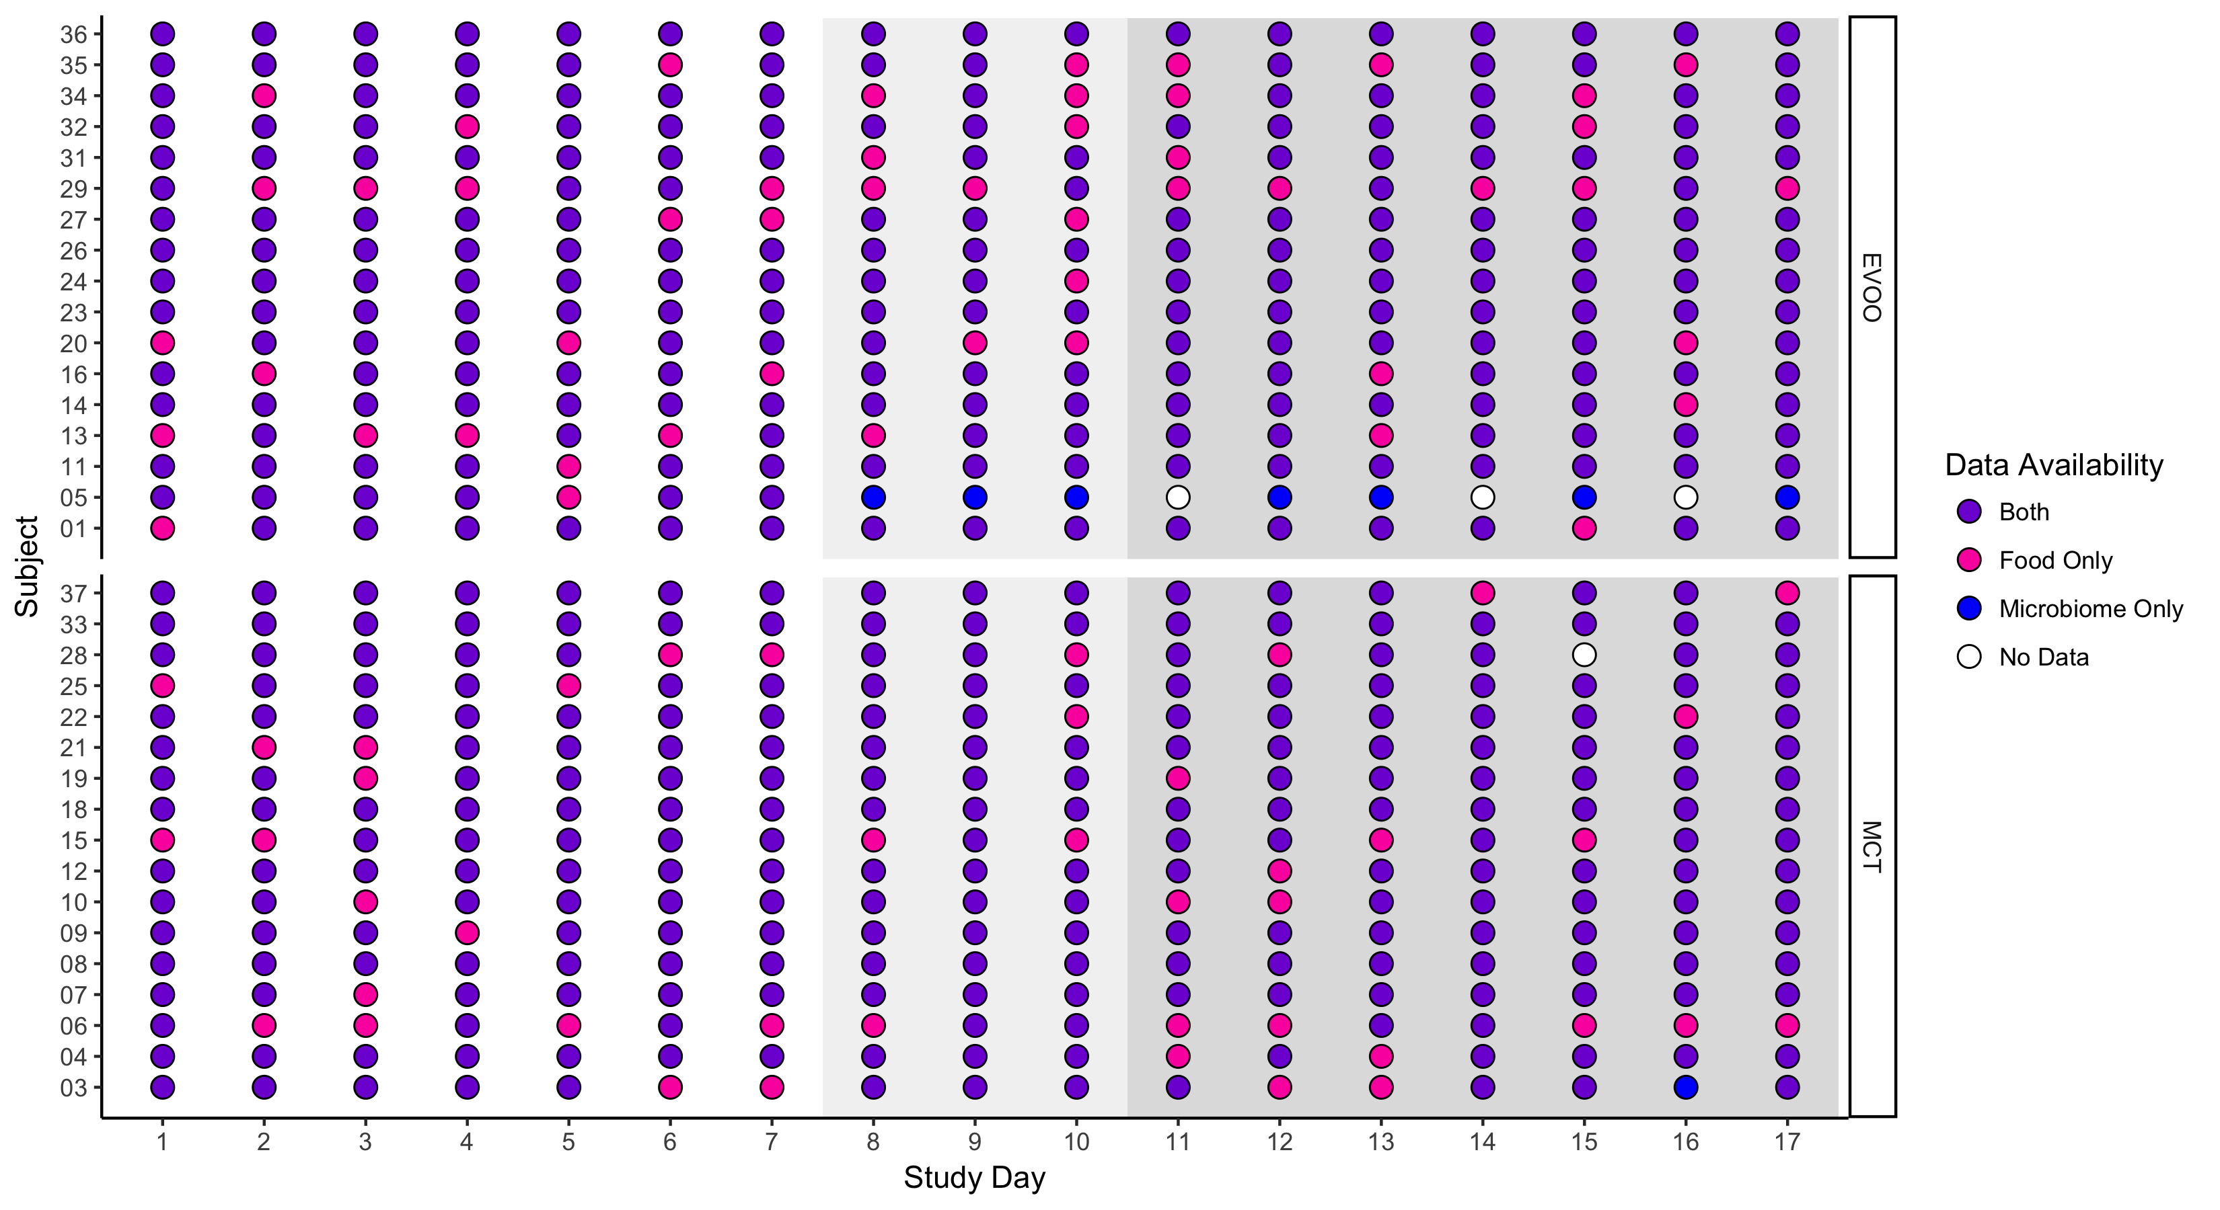
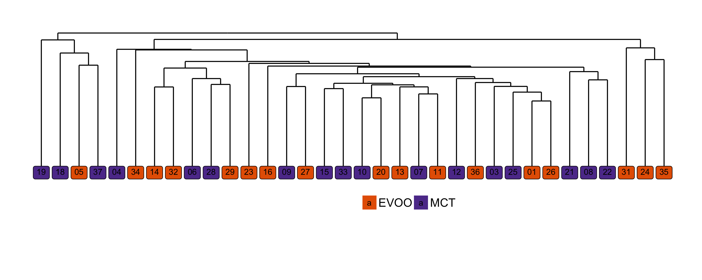
A
B
Figure S1: Timing of self sampling and dietary record collection for each subject and microbiome clustering by average similarity
Final data included in study analysis showing density of sampling. Purple points show days where both dietary intake and microbiome composition was available for a subject. Pink points are days where only food is reported and microbiome composition was unavailable either due to low depth sequencing or failure of subject to provide a sample (either due to subject inability to produce a sample or missed sample collection). Blue points are days where only microbiome data is available and dietary intake was not reported. White points indicate that no data is available for that subject on that day. Grey shading indicates the study period where the dietary supplement was consumed (study day 8 through 17). Lighter grey shading highlights the first 3 days of supplementation.
Microbiome clustering by average similarity. Clustering was determined using normalized taxonomy count data. The distance metric used was bray curtis and clustering was determined using average similarity. The order shown in this figure corresponds to the order of subjects in the Figure 1. Colors indicate the random group assignment for each subject during the supplementation period.
Notes:
Figure S1: Study design and results of the MCT supplementation trial.

Slide 7
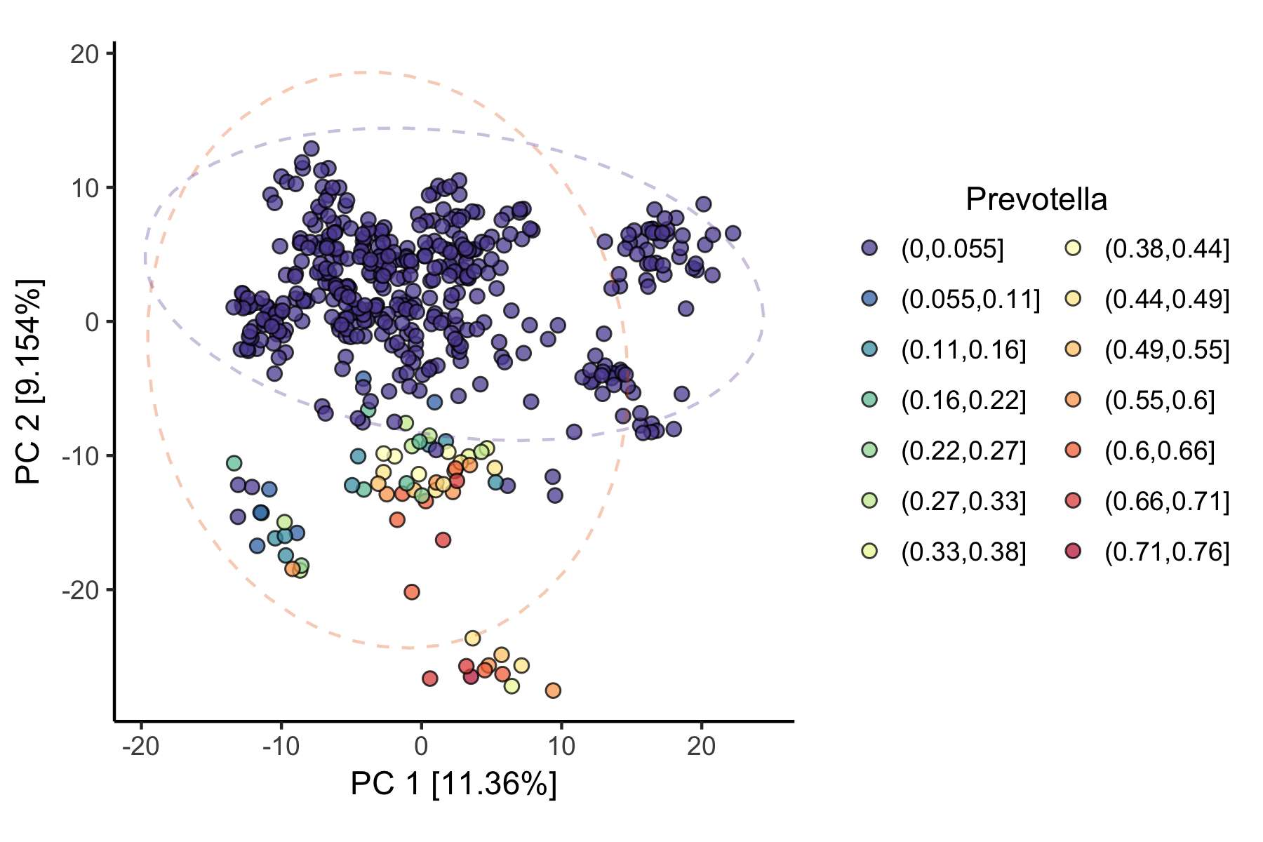
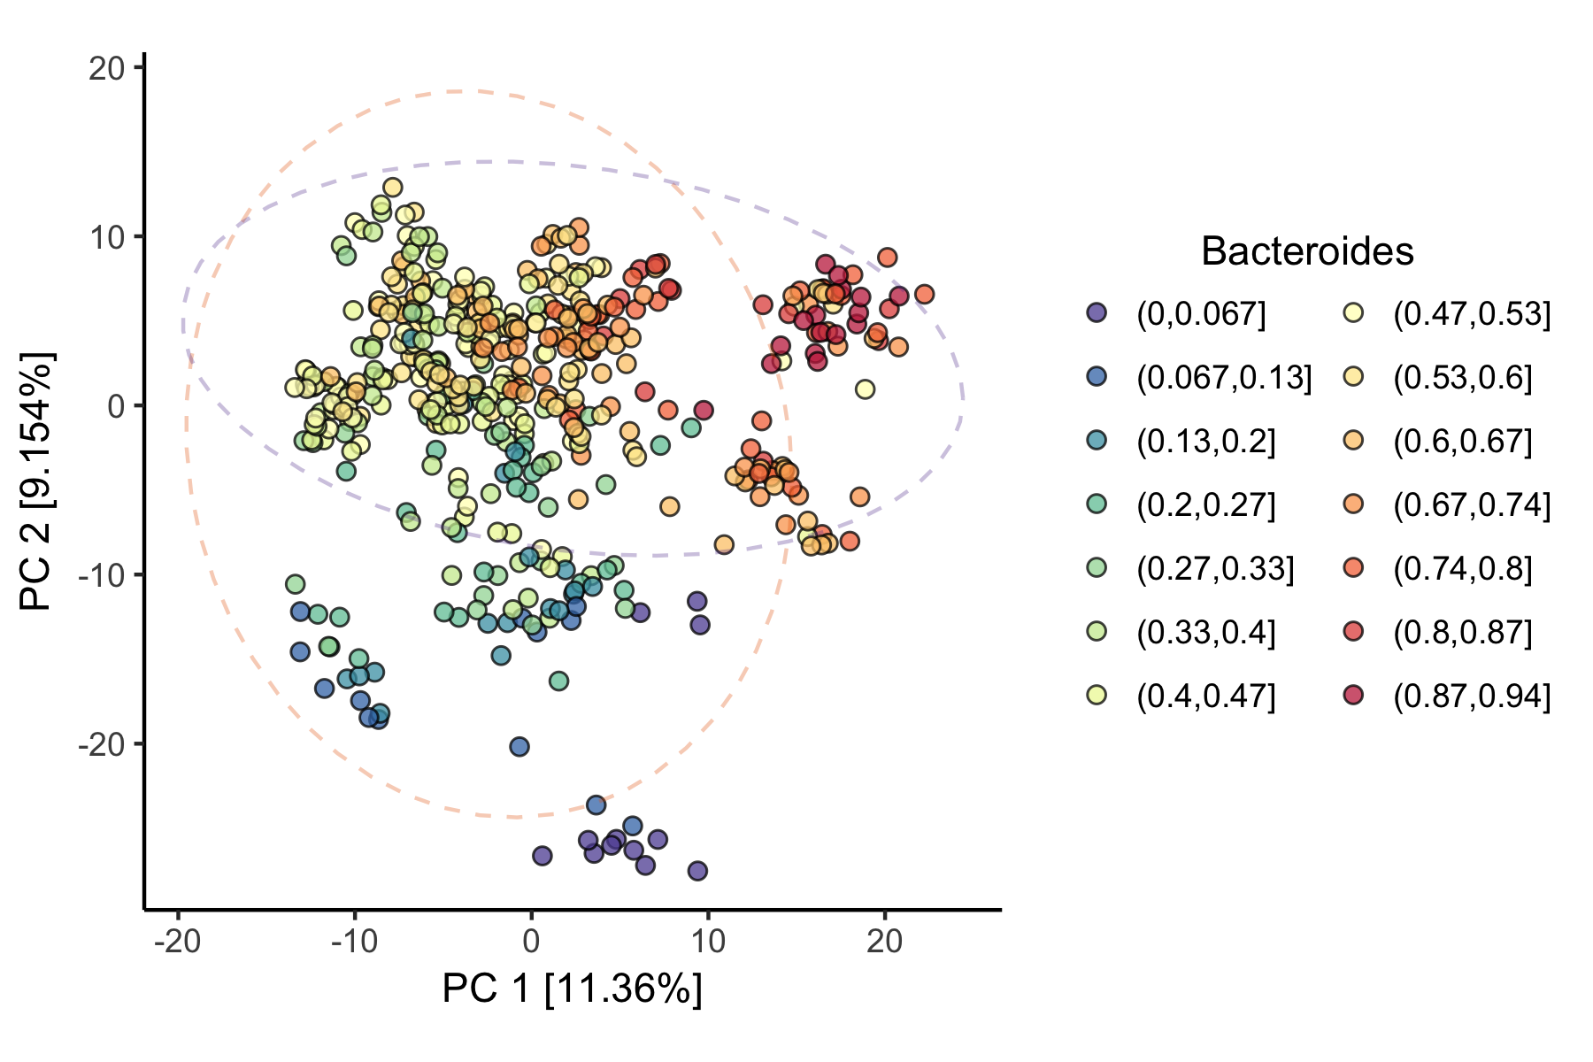
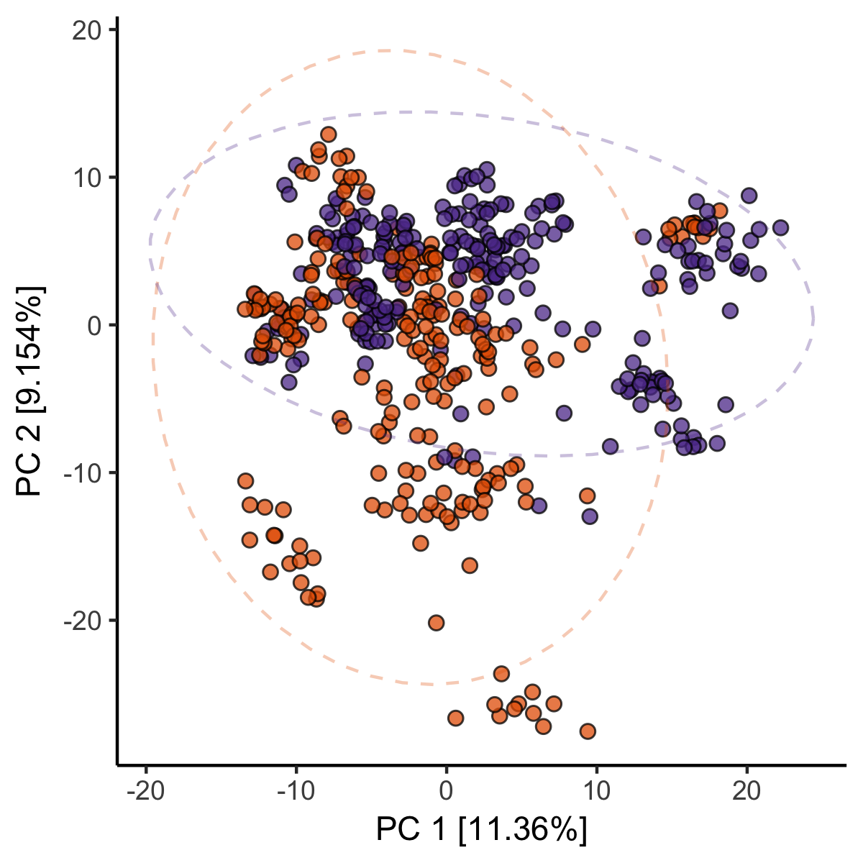
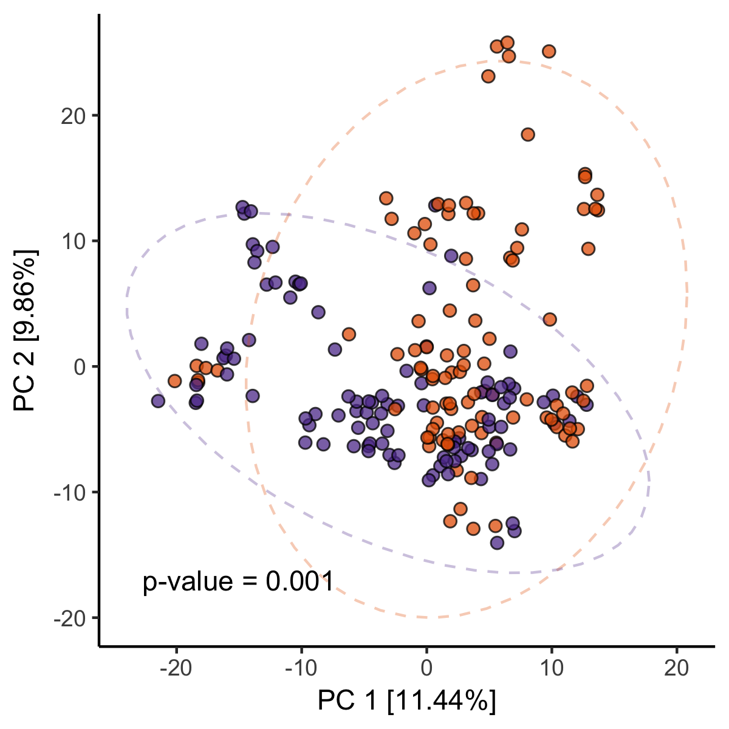
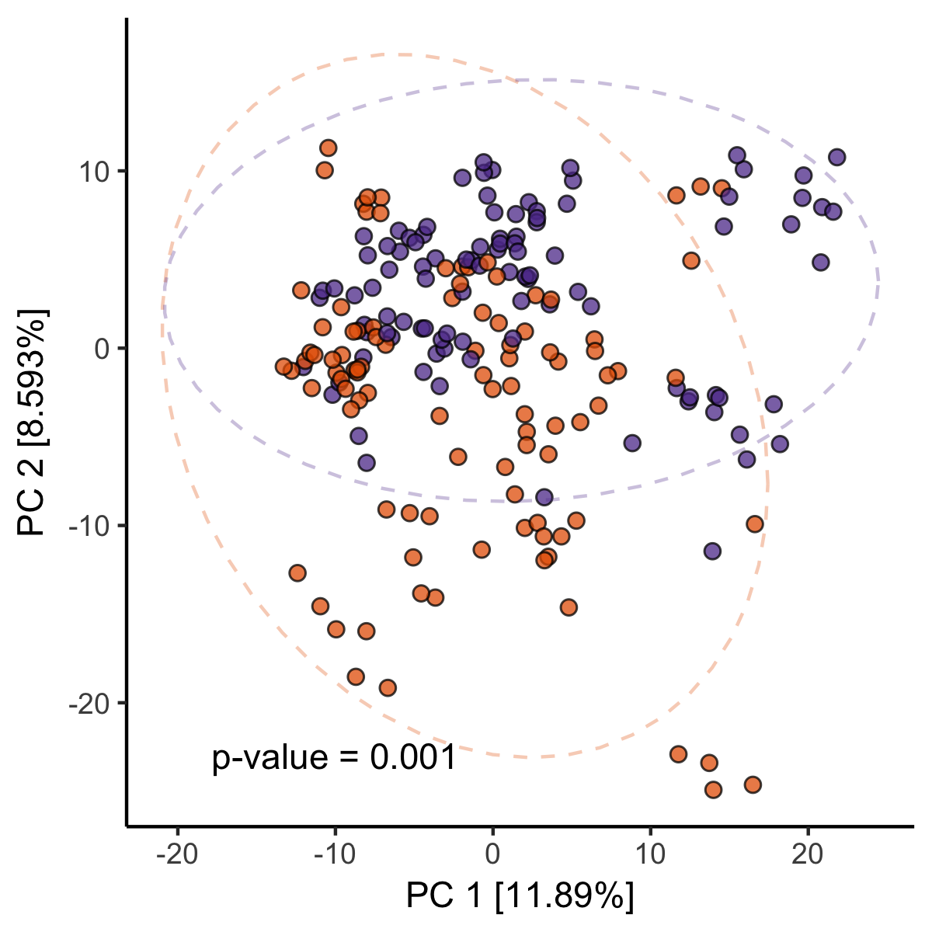
A
B
C
D
E
Figure S2: Differences post supplementation microbiome composition are explained by baseline differences after randomization to study arm.
Microbiome beta diversity (CLR Euclidean) colored by relative abundance of Prevotella in each sample. Ellipses show 95% confidence interval around samples belonging to either EVOO (orange) or MCT (purple) supplementation arms.
Microbiome beta diversity (CLR Euclidean) colored by relative abundance of Bacteroides in each sample. As in A, ellipses show supplementation group separation.
Beta-diversity (CLR-Euclidean) for all samples colored by supplementation arm. All samples for each participant are shown.
Beta-diversity (CLR-Euclidean) of samples collected from subjects prior to supplementation (PERMANOVA test, for group differences, 999 permutations) demonstrating that at baseline, there were strong between group differences due to the randomization of all the Prevotella dominated individuals to the EVOO supplementation group.
Beta-diversity (CLR-Euclidean) after supplementation (PERMANOVA test, for group differences, 999 permutations) demonstrating that the within individual clustering remains after supplementation and microbiomes are still different between the supplementation arms.

Slide 8
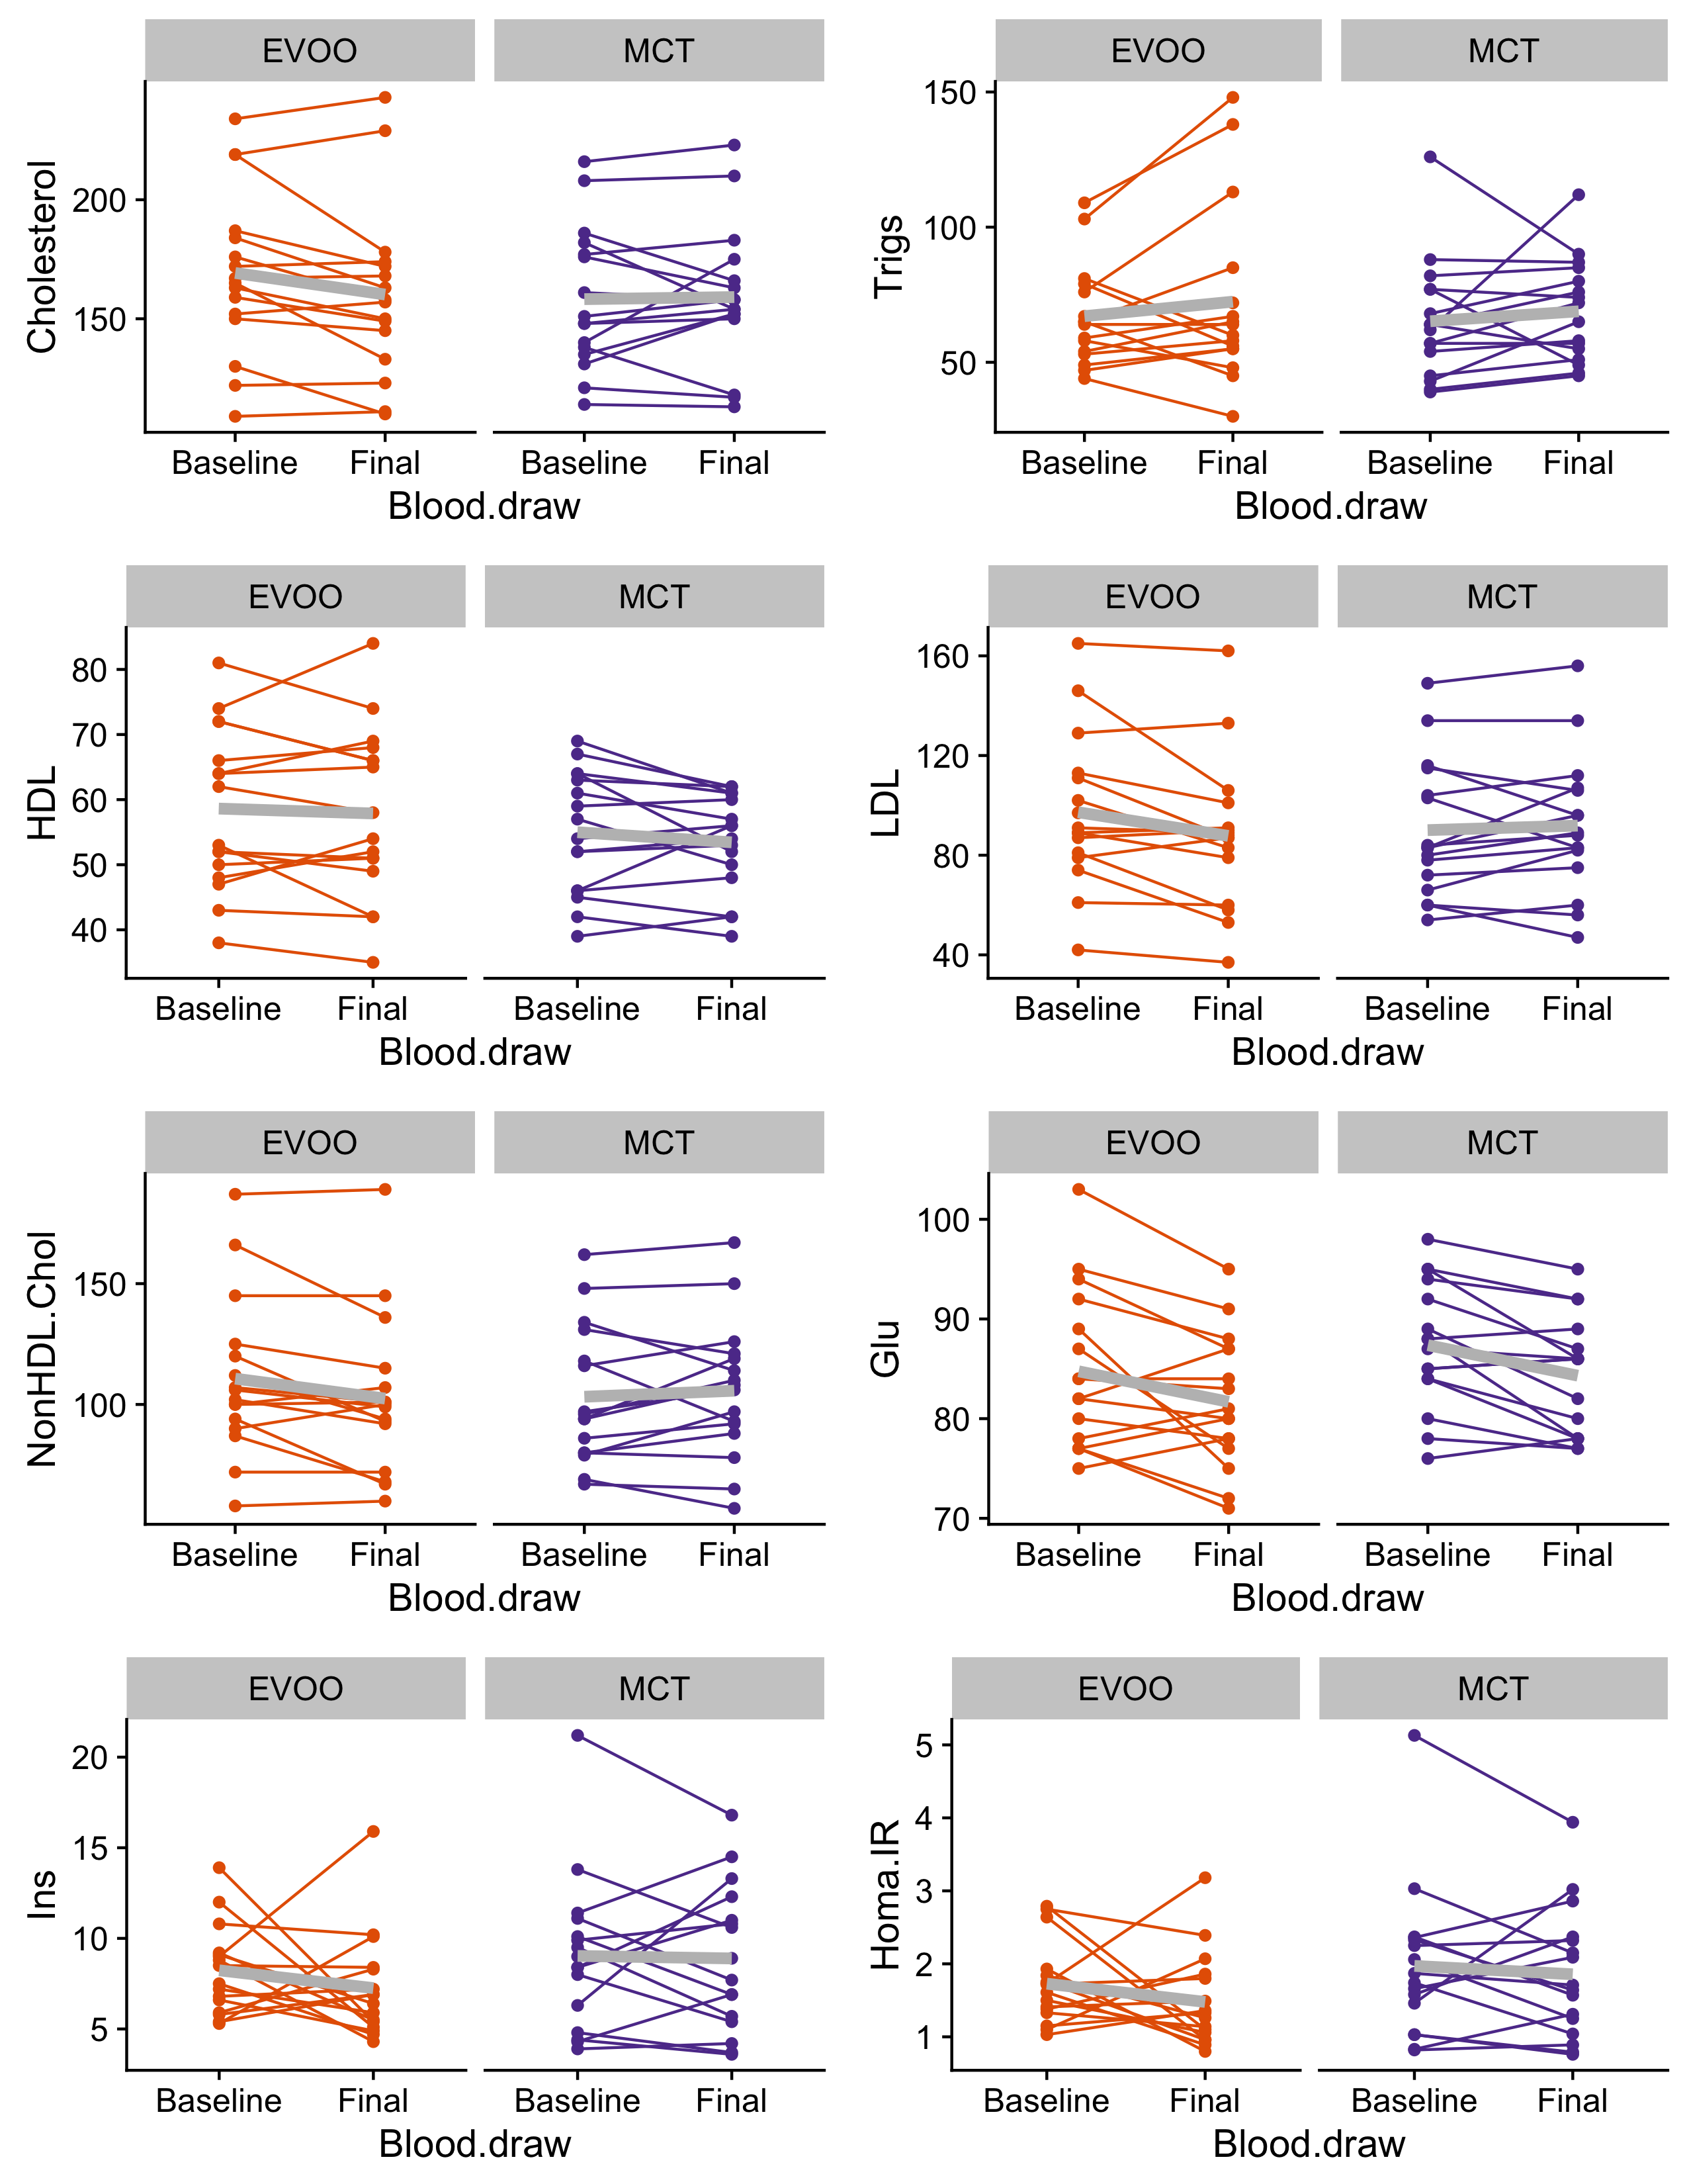
A
B
C
D
E
F
G
H
Figure S3: Serum biomarkers before and after supplementation with dietary oils
Paired comparisons between A) cholesterol, B) triglycerides (Trigs), C) High Density Lipoprotein (HDL), D) Low Density Lipoprotein (LDL), E) Non-HDL cholesterol (NonHDL.Chol), F) Glucose (Glu), G) Insulin (Ins), and H) Homeostatic Model Assessment for Insulin Resistance (Homa.IR) are not significantly different between supplementation arms. All FDR-corrected p-values > 0.05 (paired Student’s t-test). Points indicate measured values at each time point, joined by lines between the same subject. Overlaid light grey lines show mean change from baseline for each group. Orange points show data from olive oil participants (EVOO) and purple points show data from medium chain triglyceride participants (MCTs).
Notes:
Figure S3:

Slide 9
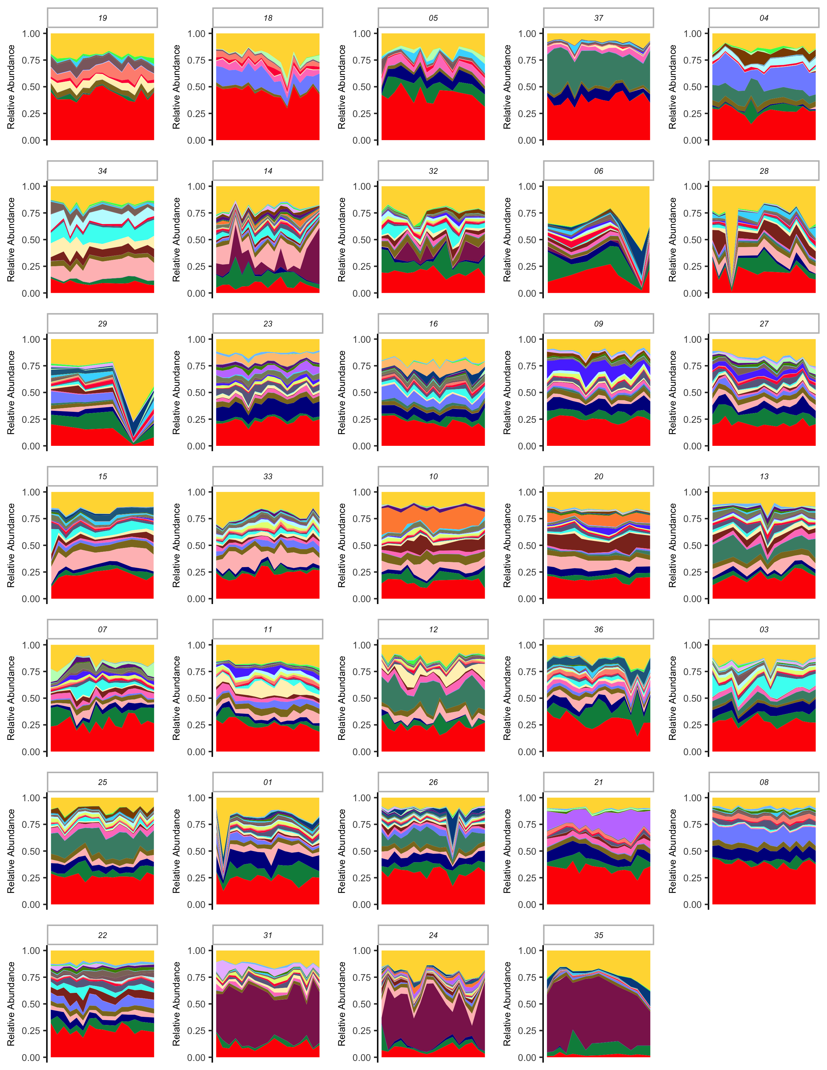
Figure S4 related to Figure 1: Daily microbiome composition by subject
Area charts showing relative abundance of the highest prevalence taxa in the data set for each subject by day over the study time course. Low abundance taxa are grouped together as “other”.

Slide 10
Figure S5 : Next day microbiome is more similar to previous day microbiome within a person
Waiting for Ben to write some text to explain this figure.

Slide 11
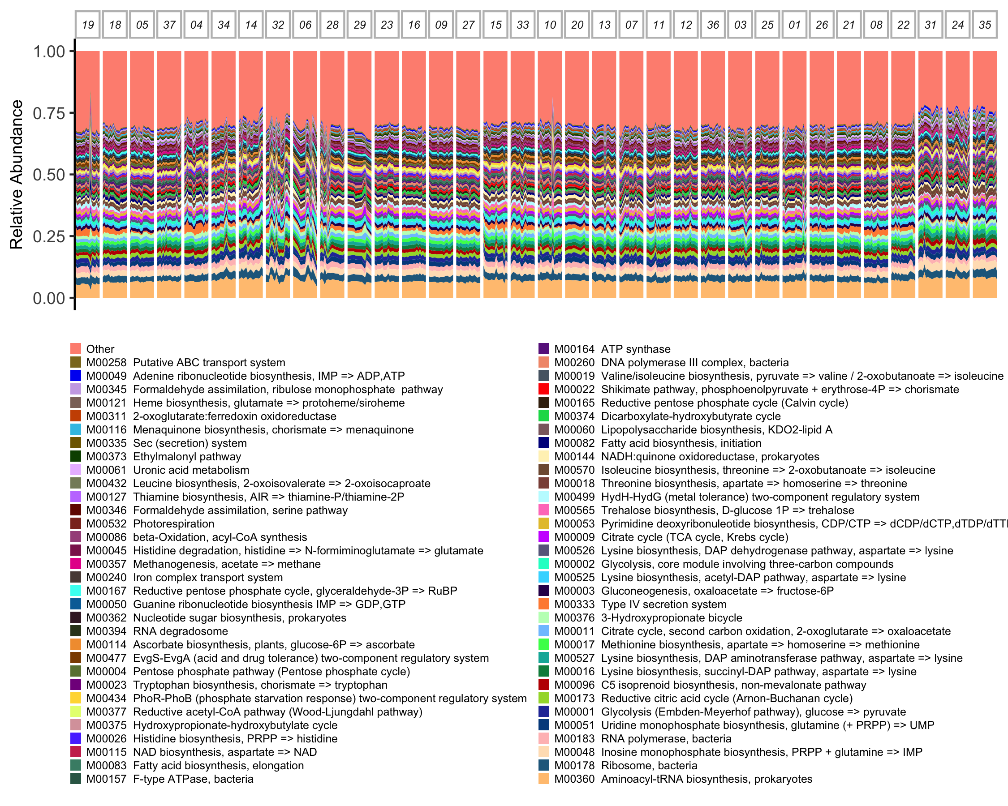
Figure S6: Common functions are stable within and between subjects

Slide 12
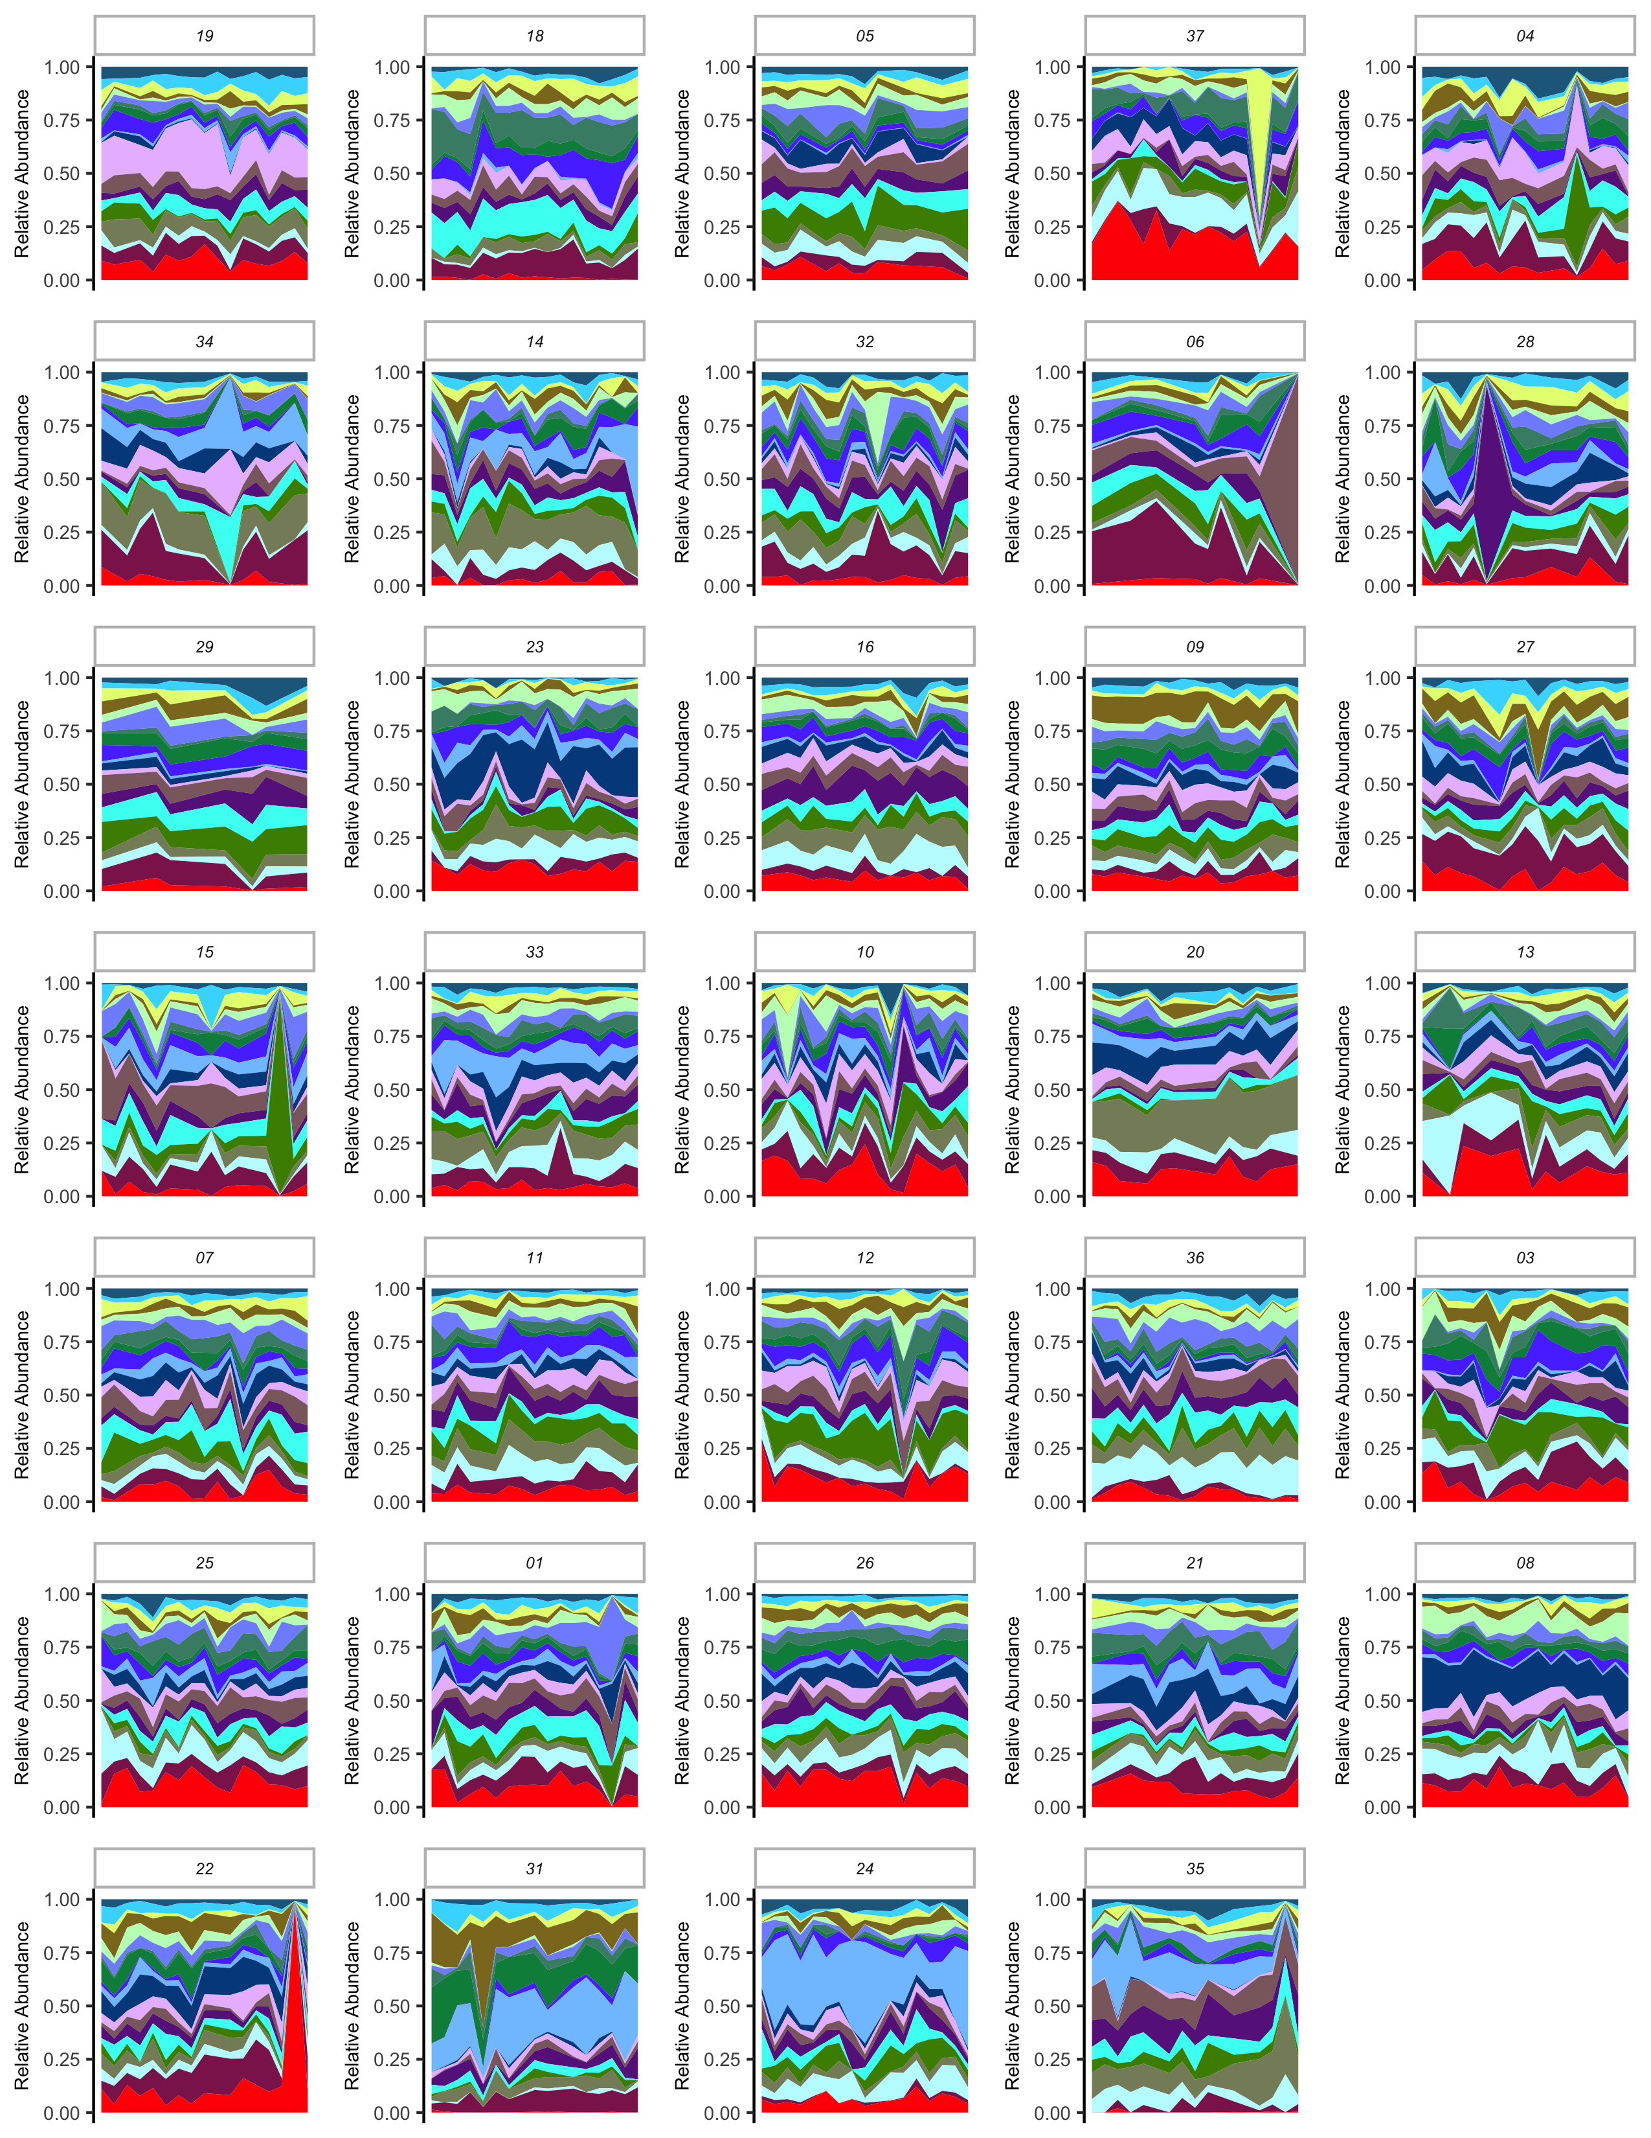
Figure S7 related to Figure 1: Highly variable functions per person
Area charts showing relative abundance of the most variable functions in the data set for each subject by day over the study time course.

Slide 13
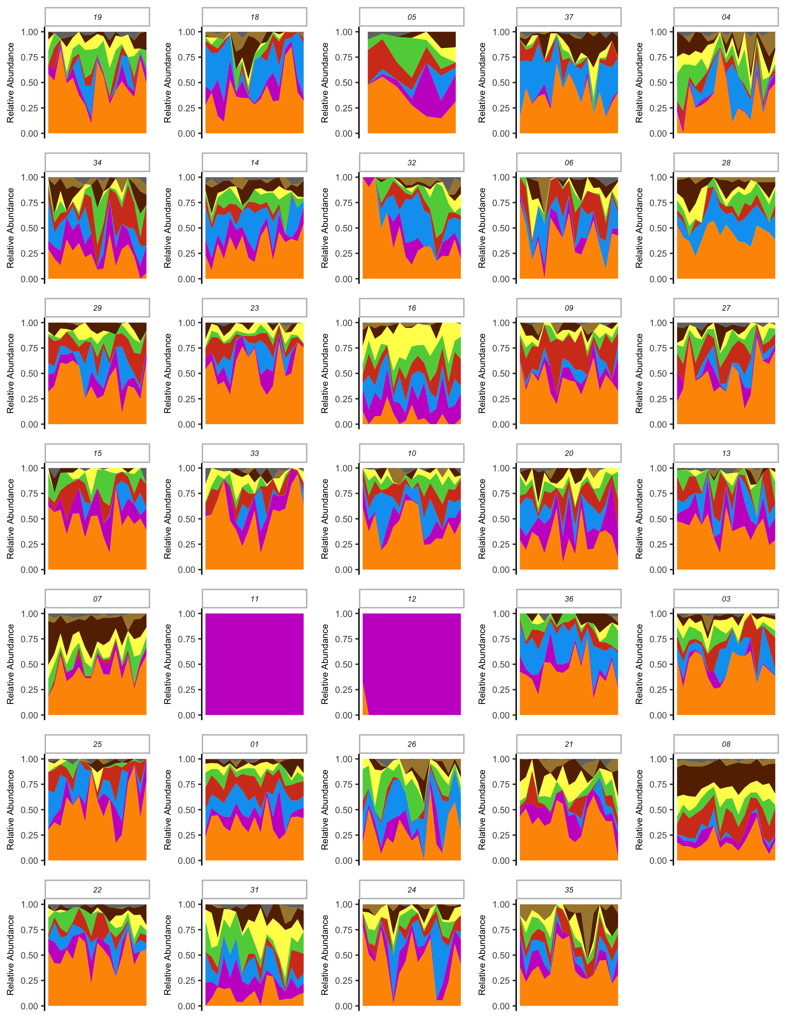
Figure S8 related to Figure 1: Dietary intake as food groups by person

Slide 14
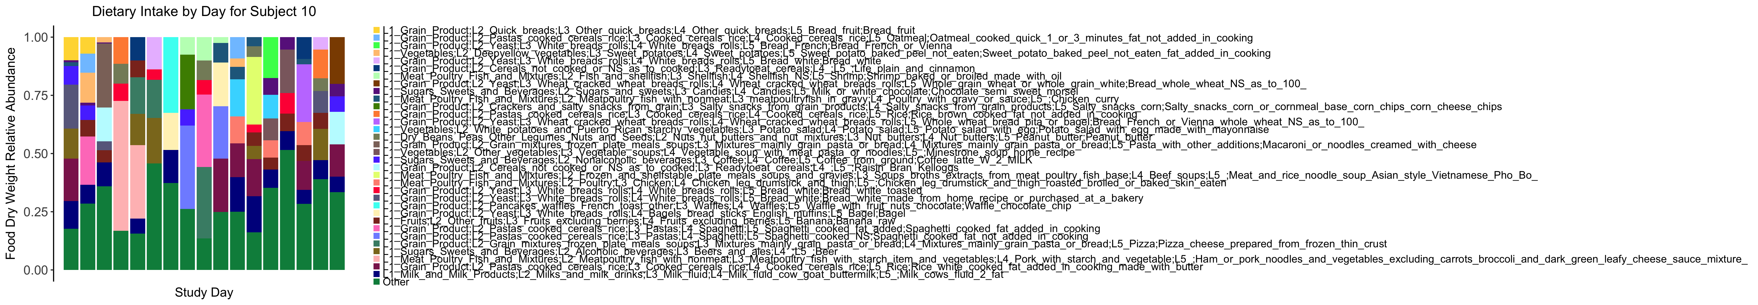
Figure S9: Individual food intake for one representative subject

Slide 15
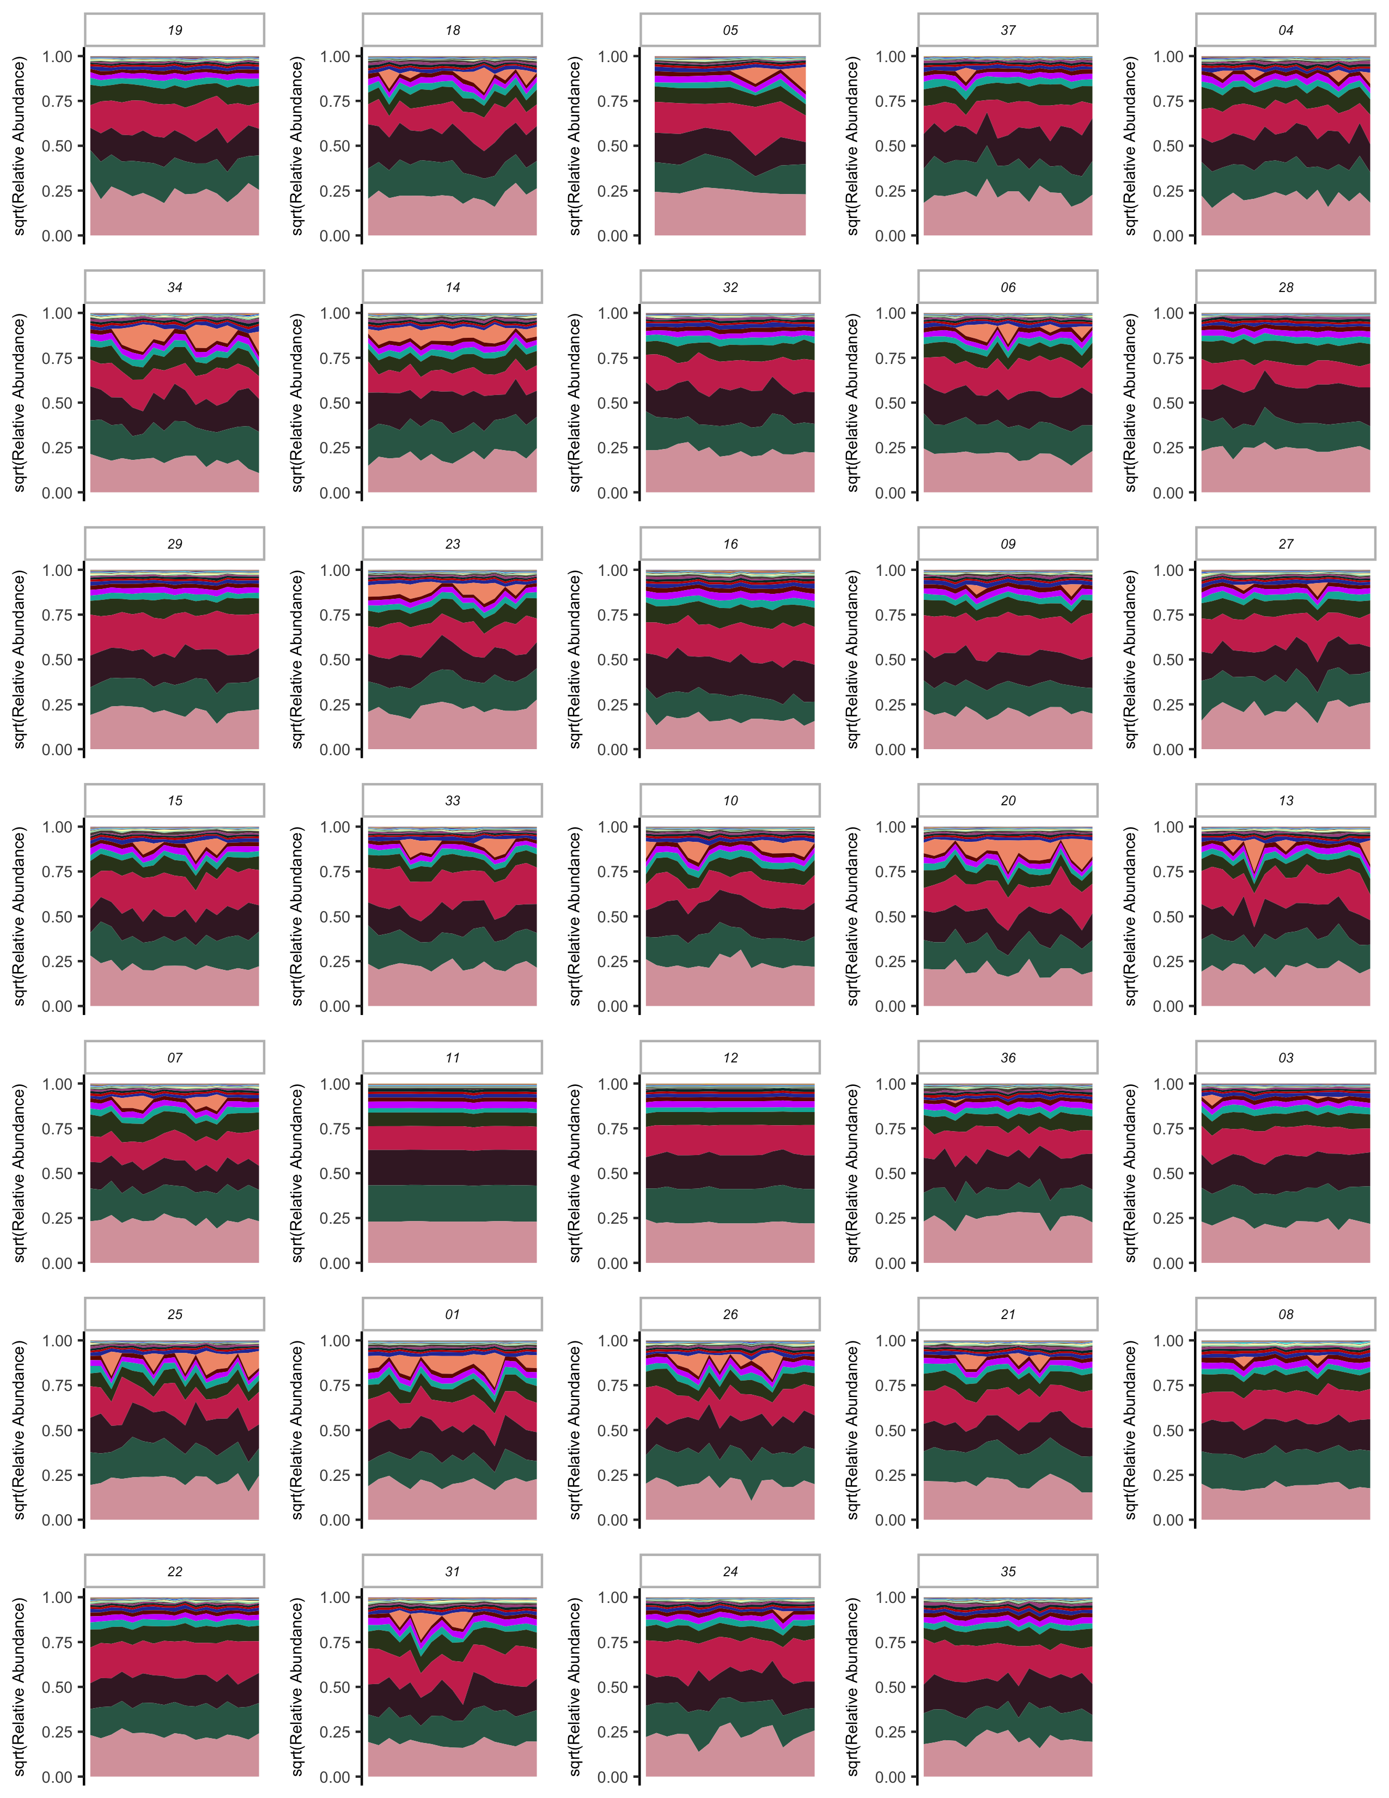
Figure S10: Nutrients per person

Slide 16
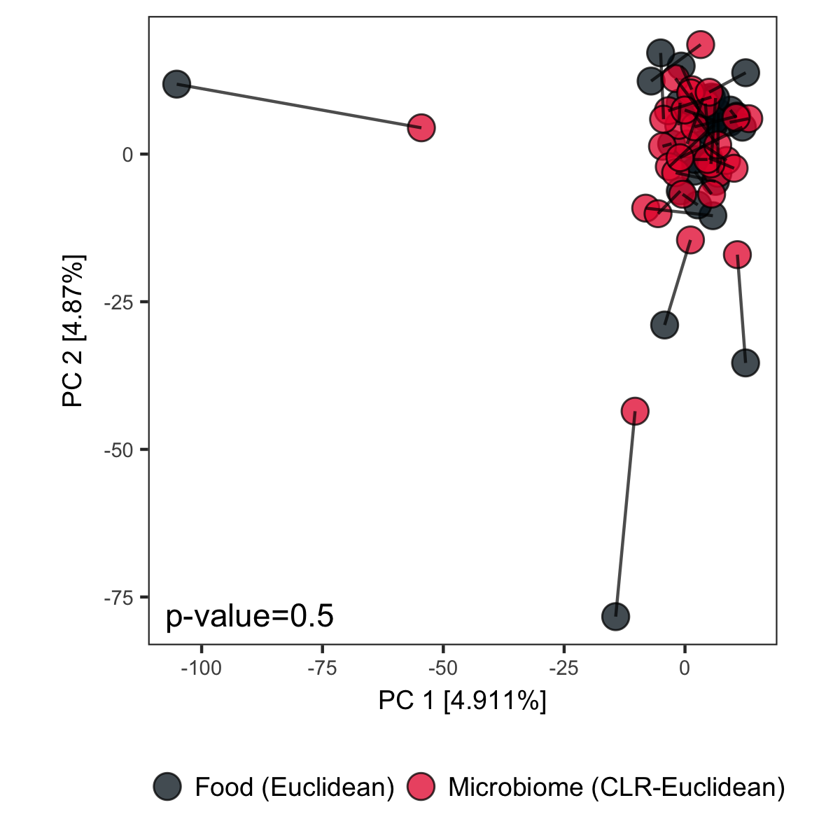
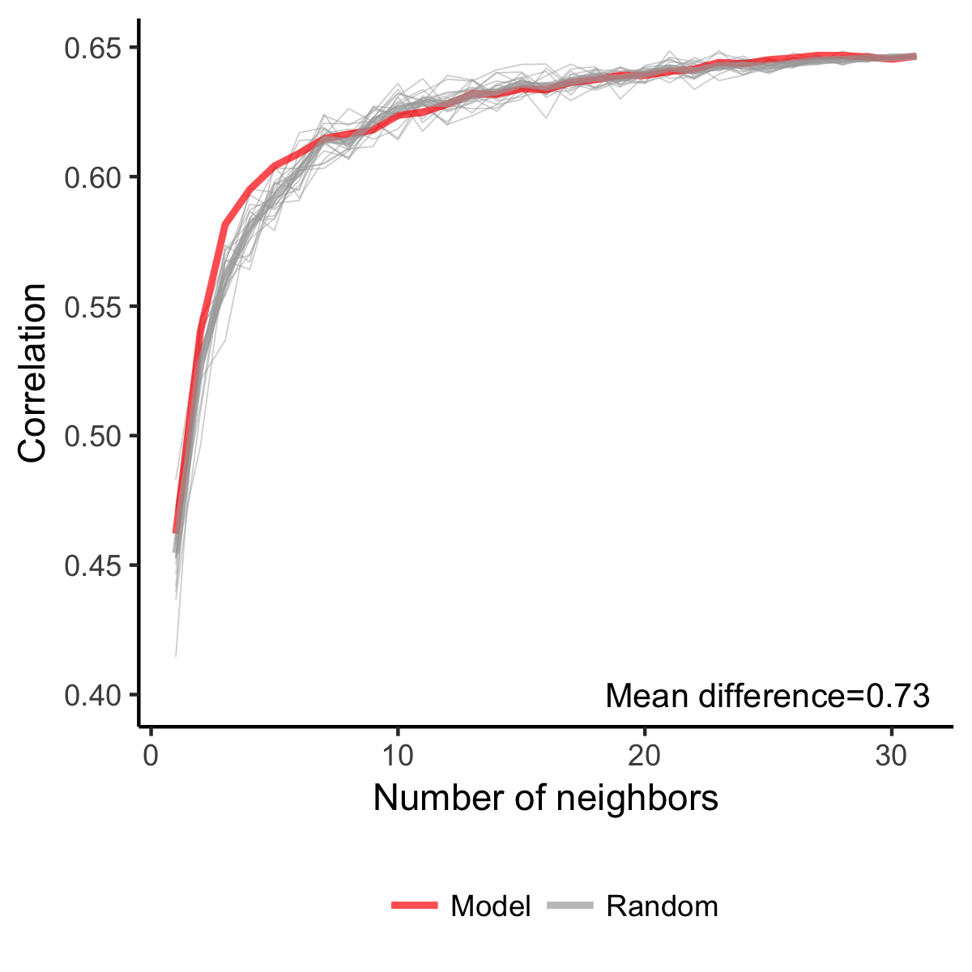
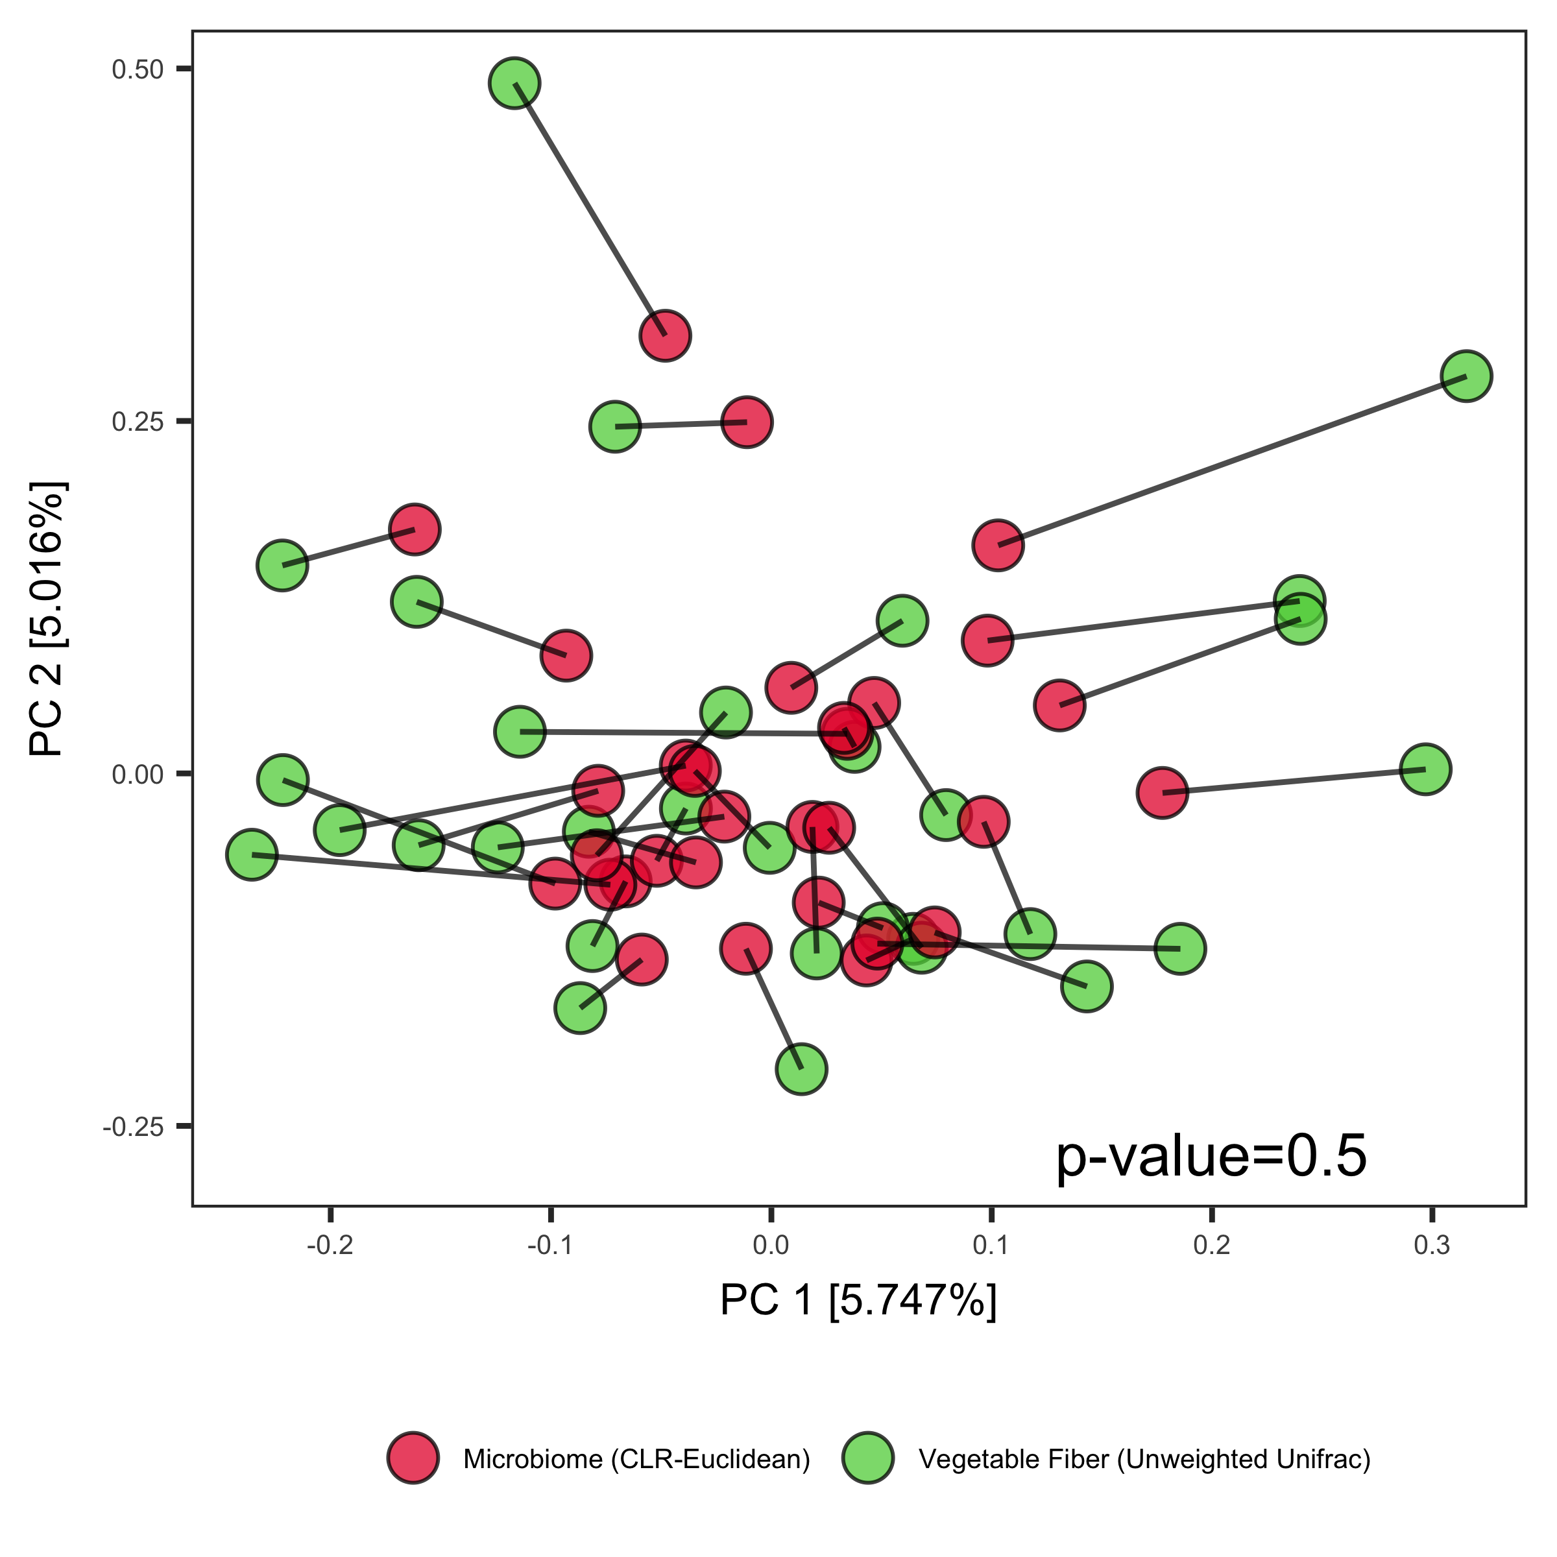
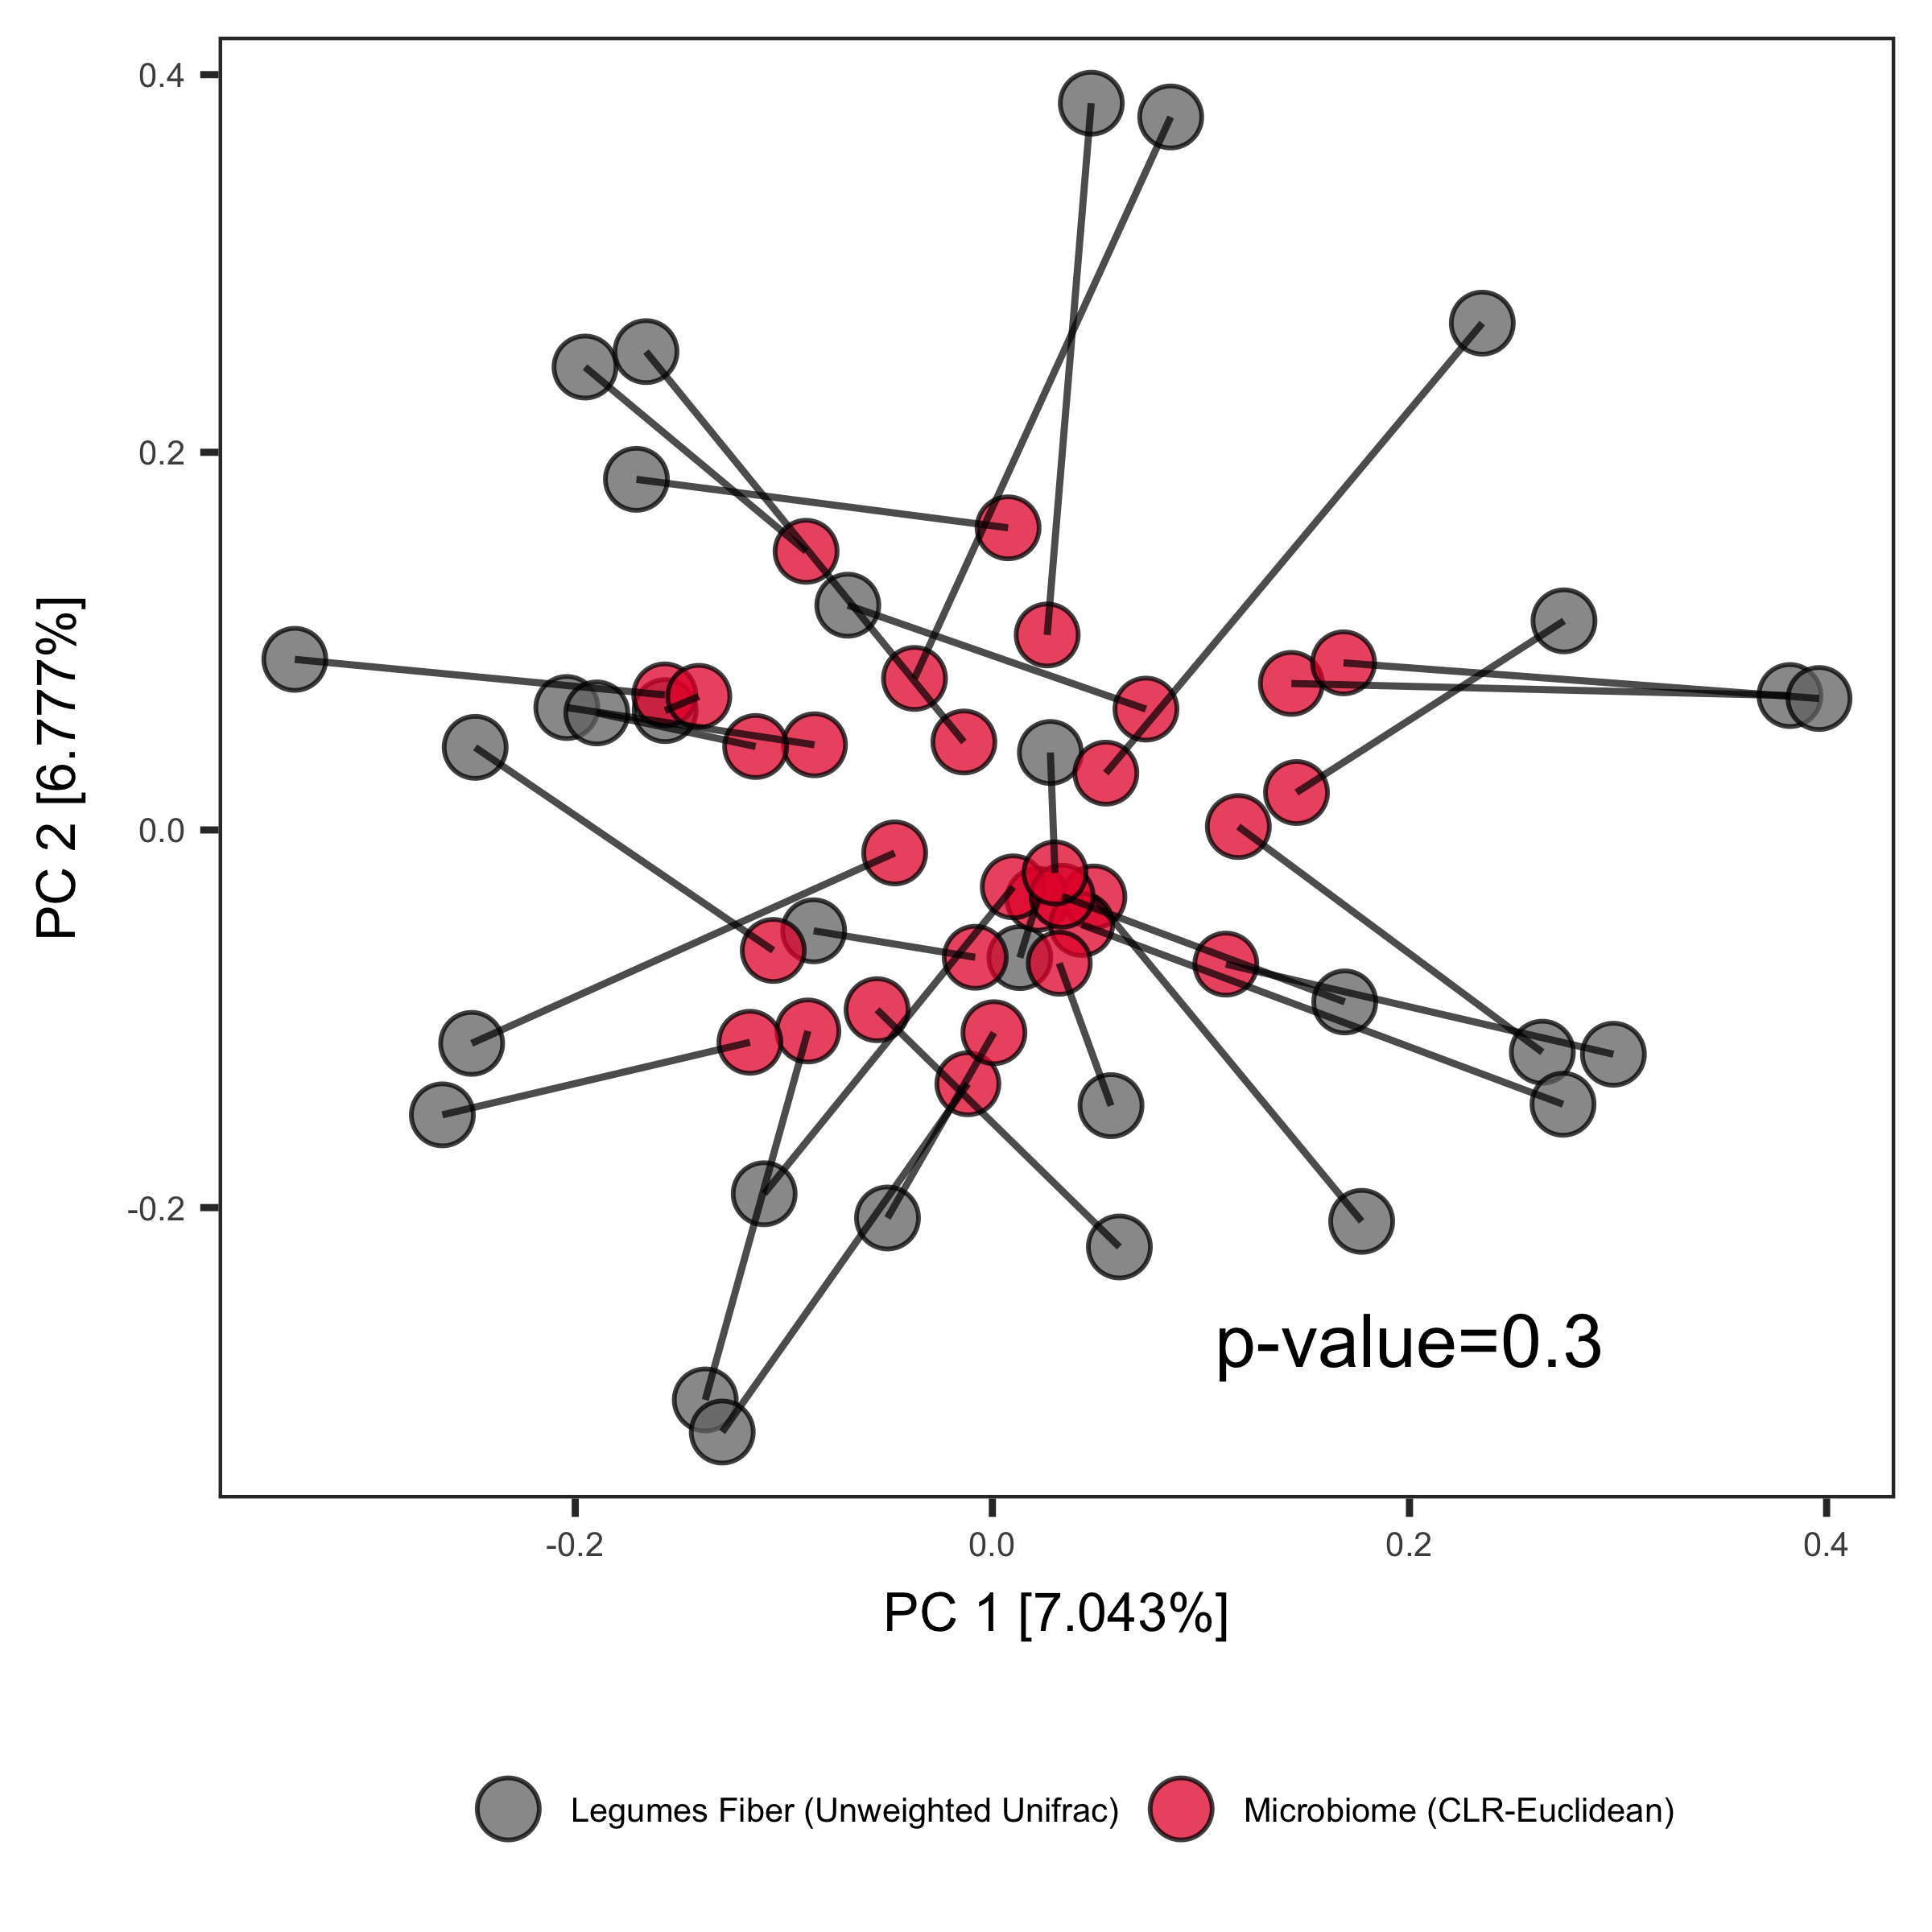
A
B
C
D
Figure S11 related to Figure 3:
Without tree-based metric, food choices do not pair with microbiome composition.
Dietary intake predicts microbiome composition marginally better than chance.
Vegetable fiber β-diversity does not pair with microbiome composition.
Legume fiber β-diversity does not pair with microbiome composition.
Notes:
Figure S11:

Slide 17
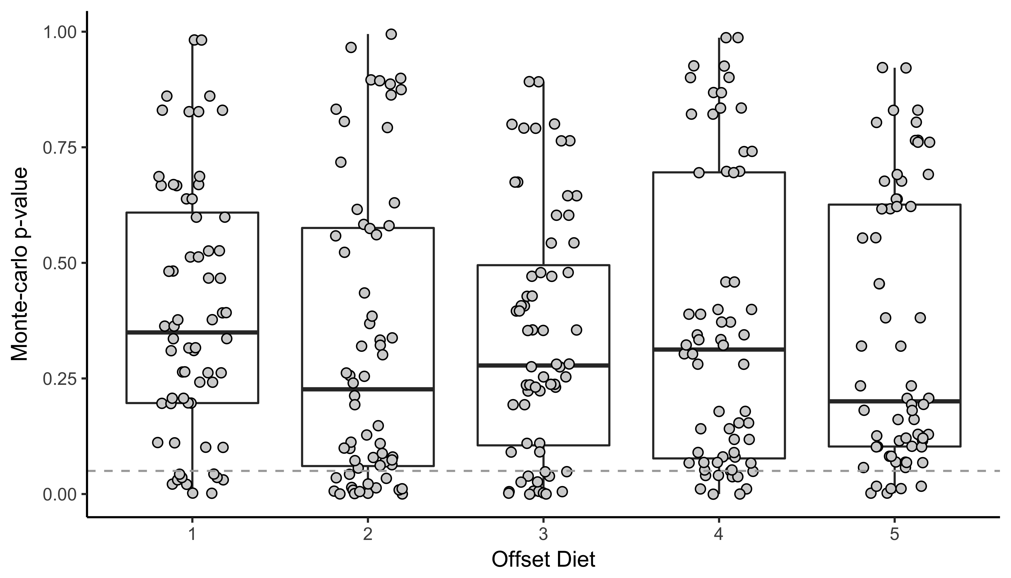
Notes:
Figure S12

Slide 18
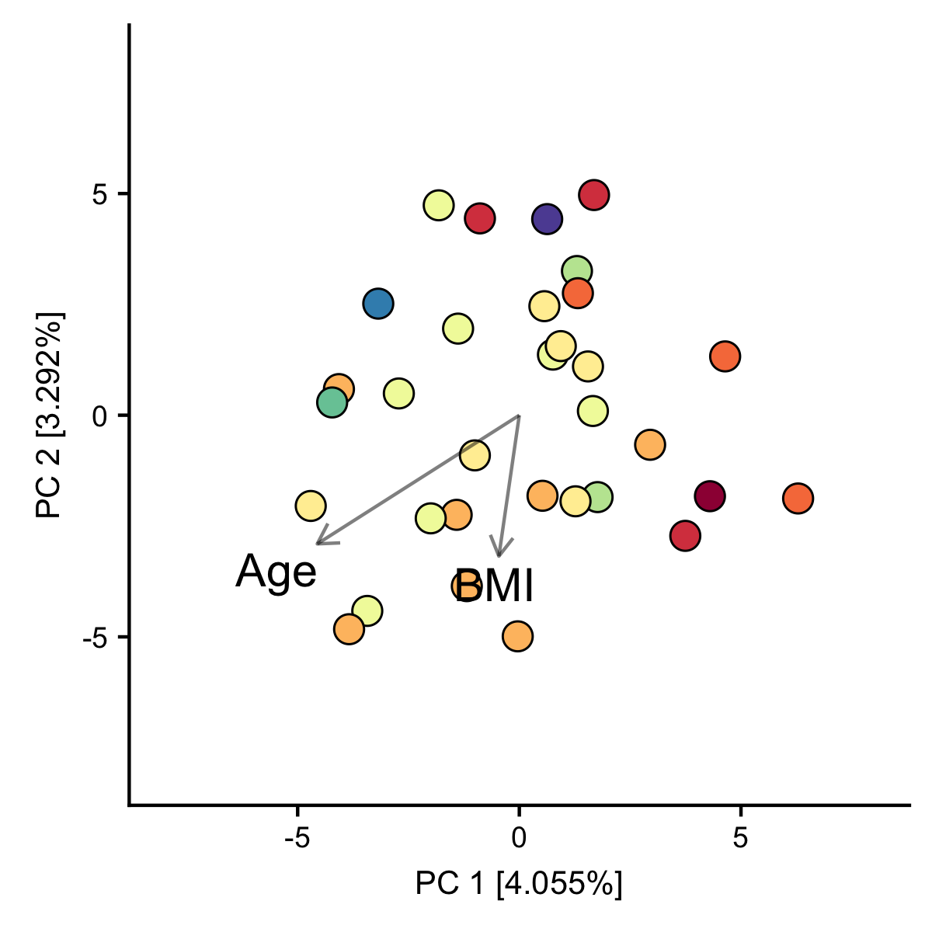
Notes:
Figure S13: Gender included in constrained ordination, but not shown. Work out how to add?

Slide 19
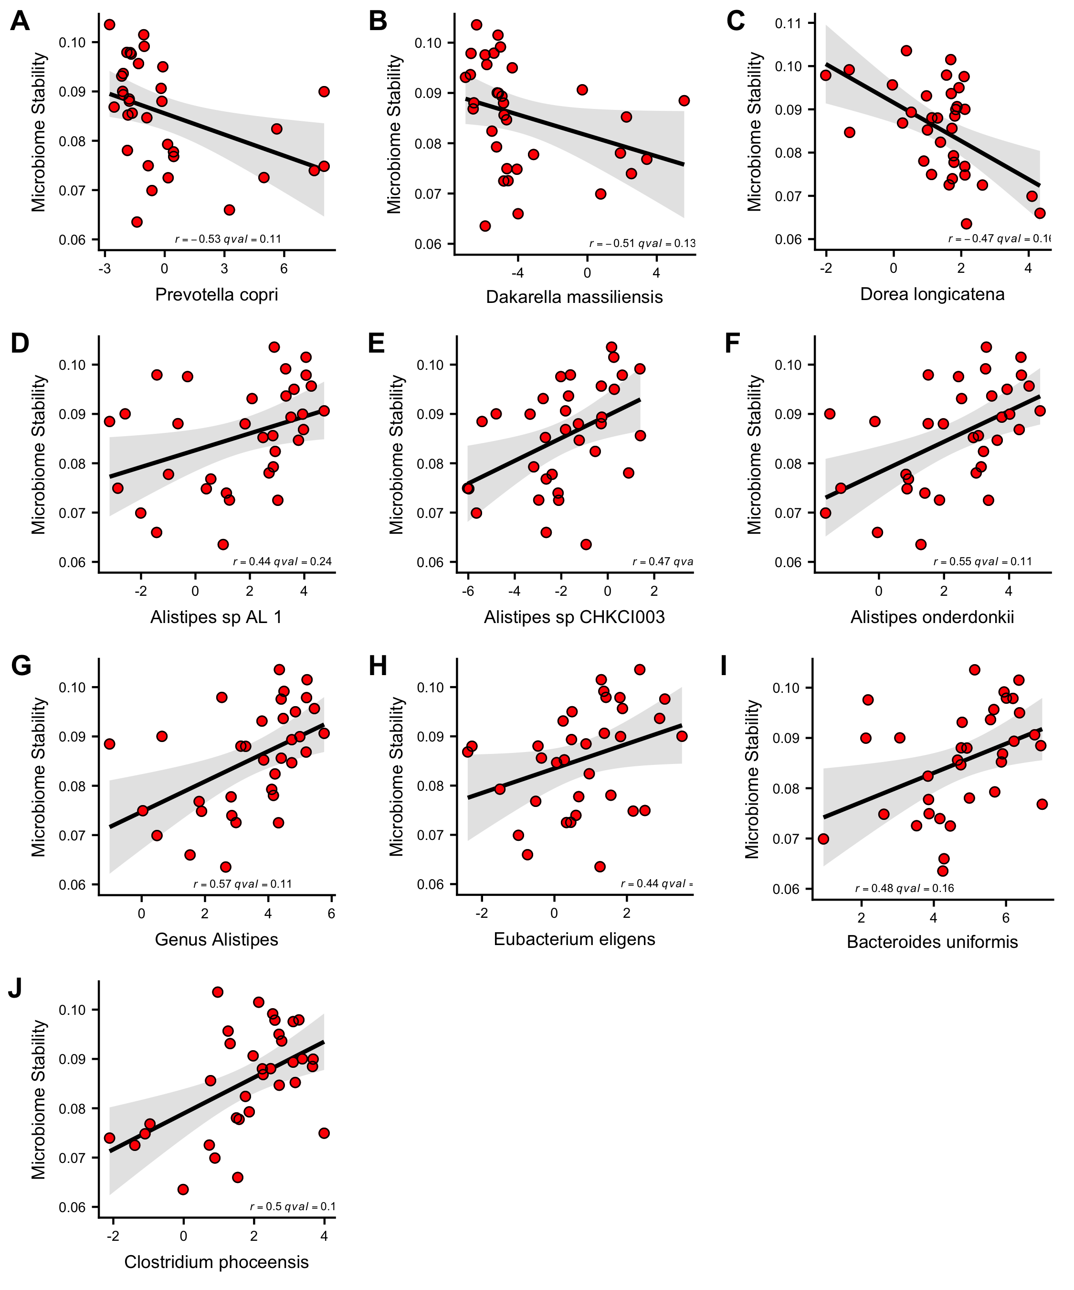

Slide 20
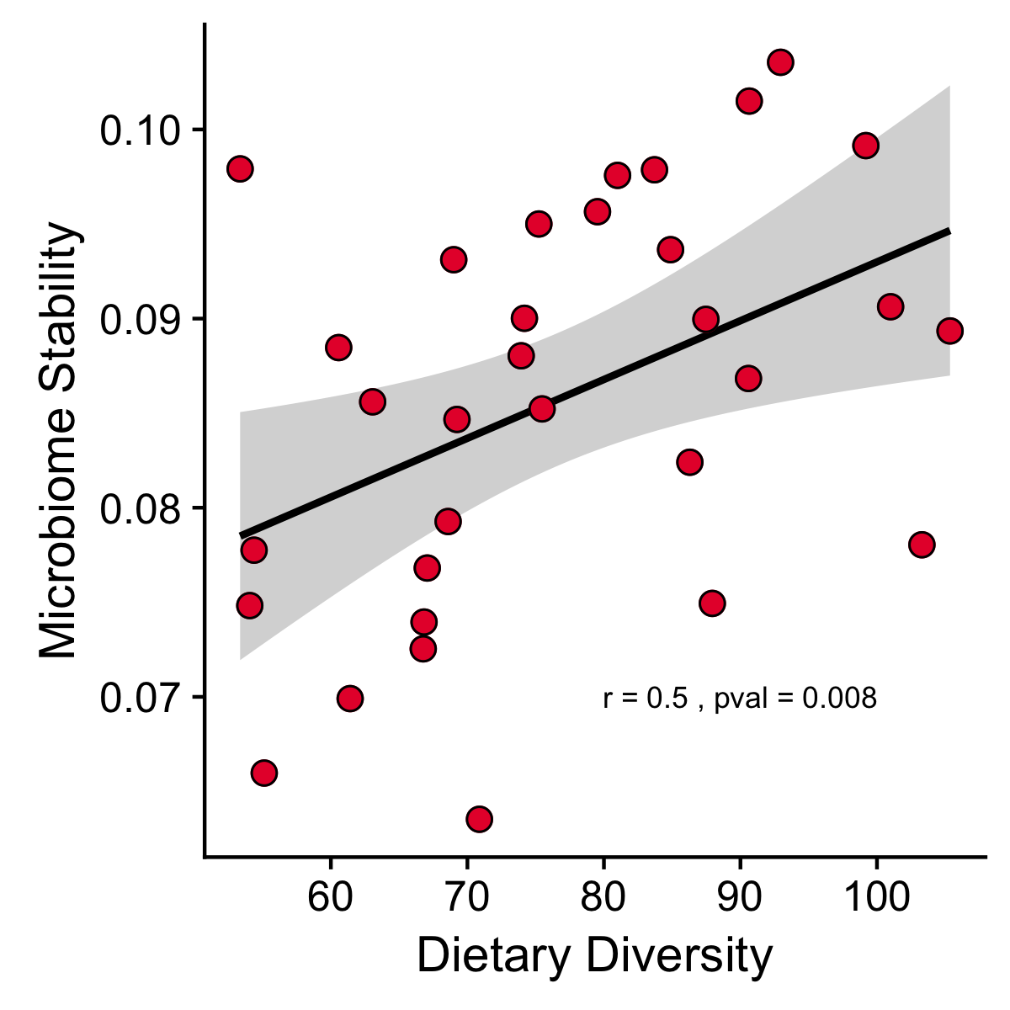

Slide 21
